Slide 1
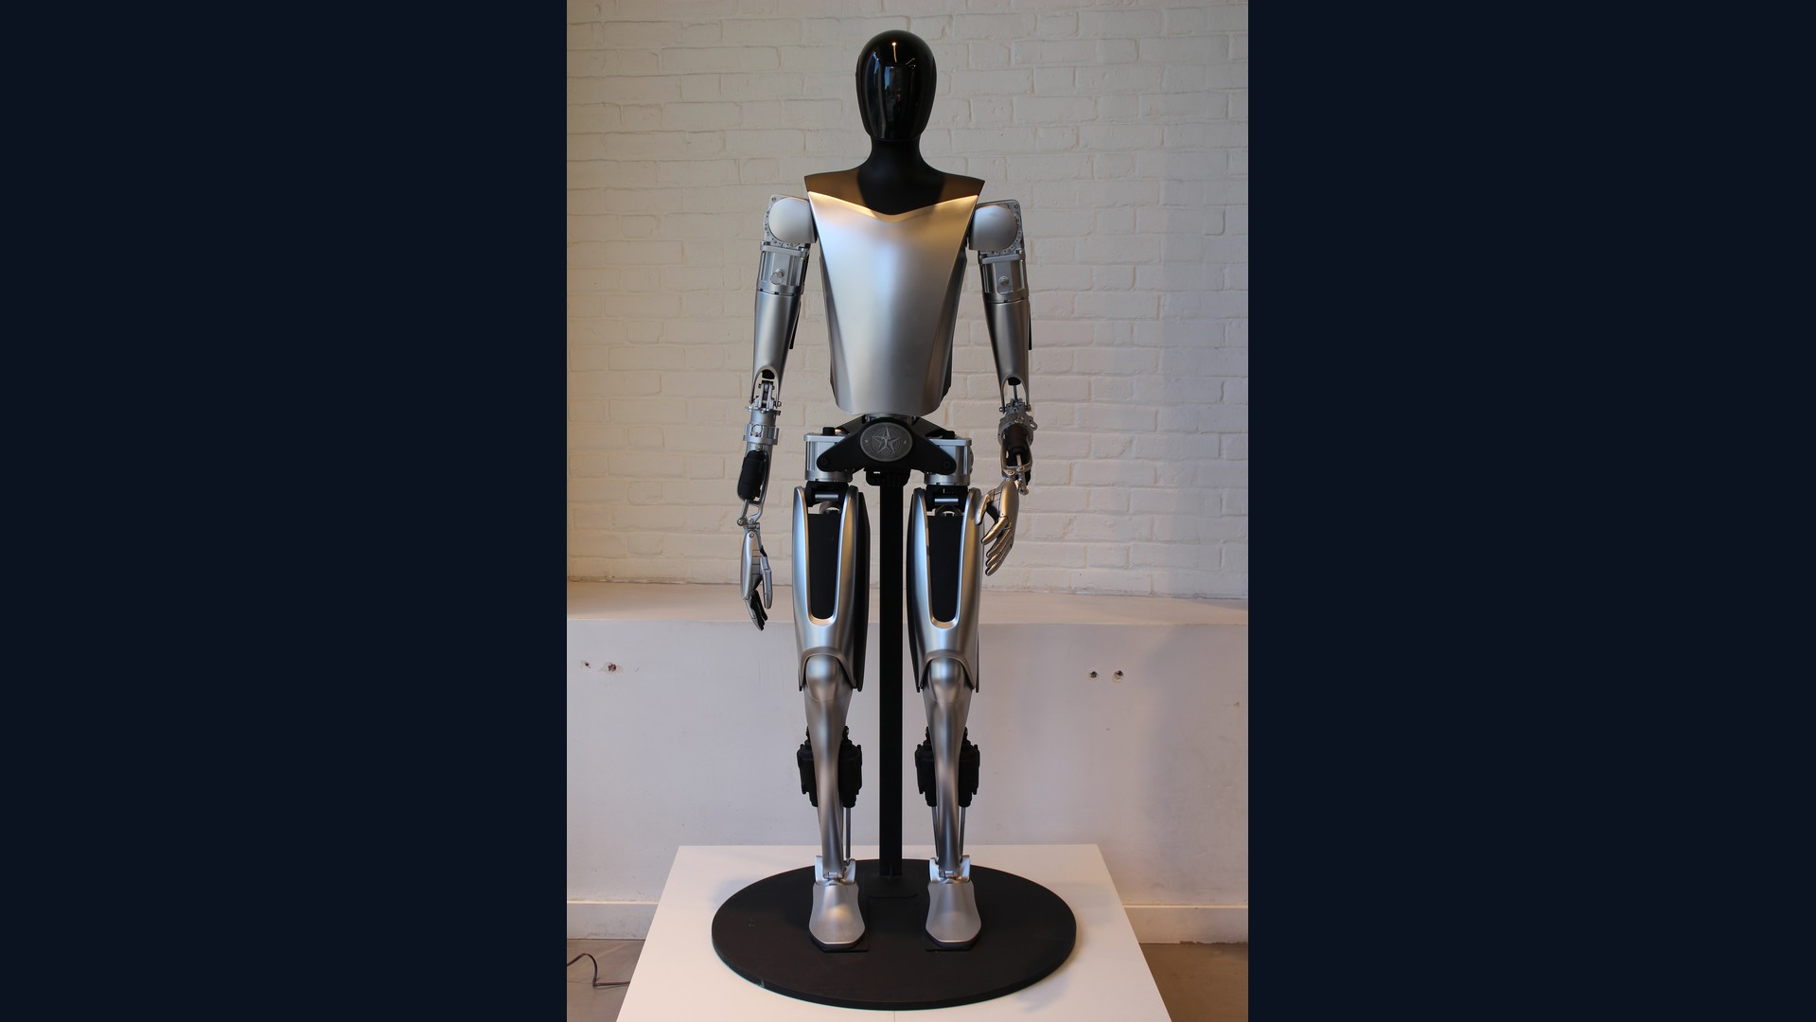

2 September 2026
Nine roadmaps. One stack.
Musk Technology Roadmaps · muskroadmaps.com
Author: Bernard de Groot, assisted by Grok Bots
muskroadmaps.com · not affiliated
Wikimedia Commons
engineering, not politics

Slide 2
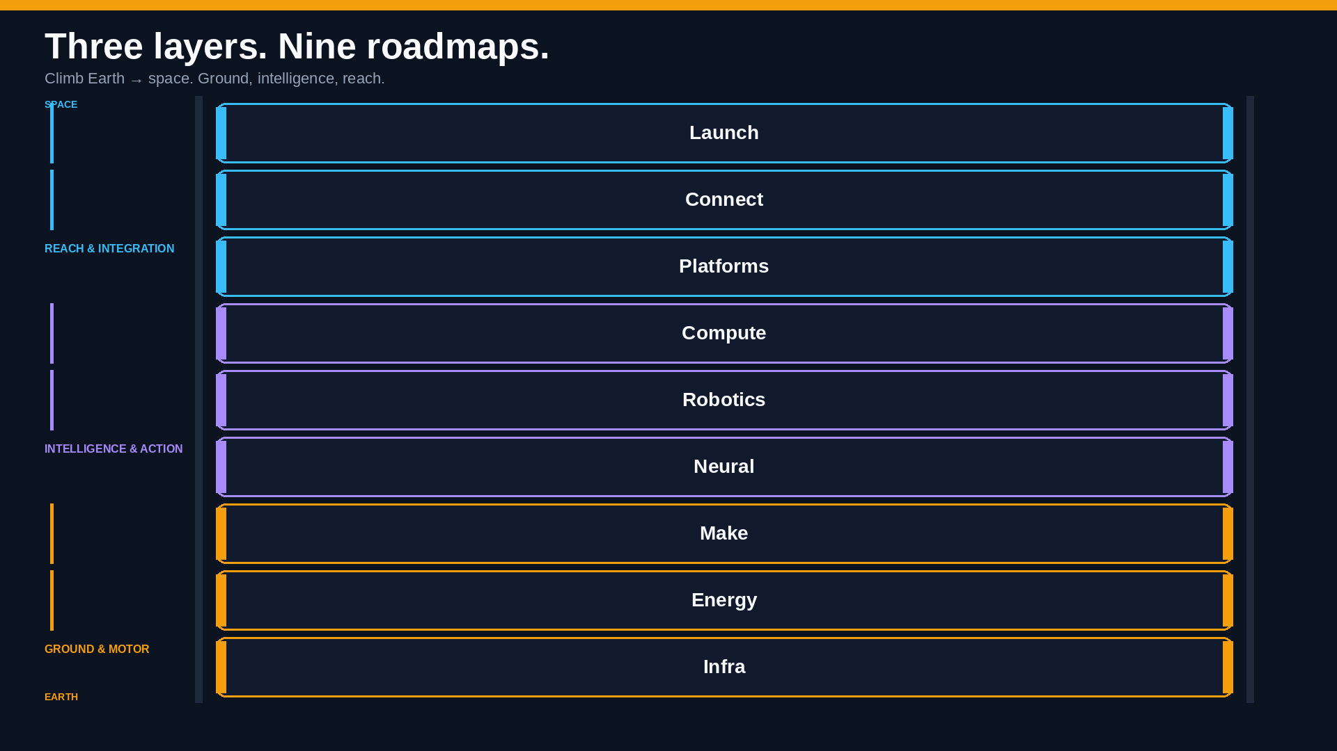
muskroadmaps.com · not affiliated
engineering, not politics

Slide 3
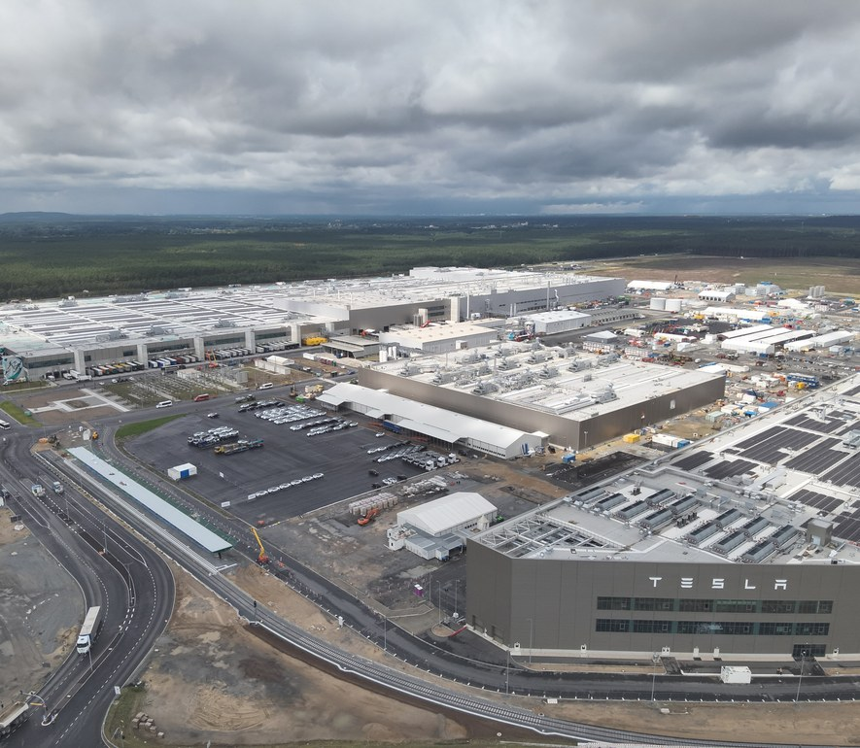
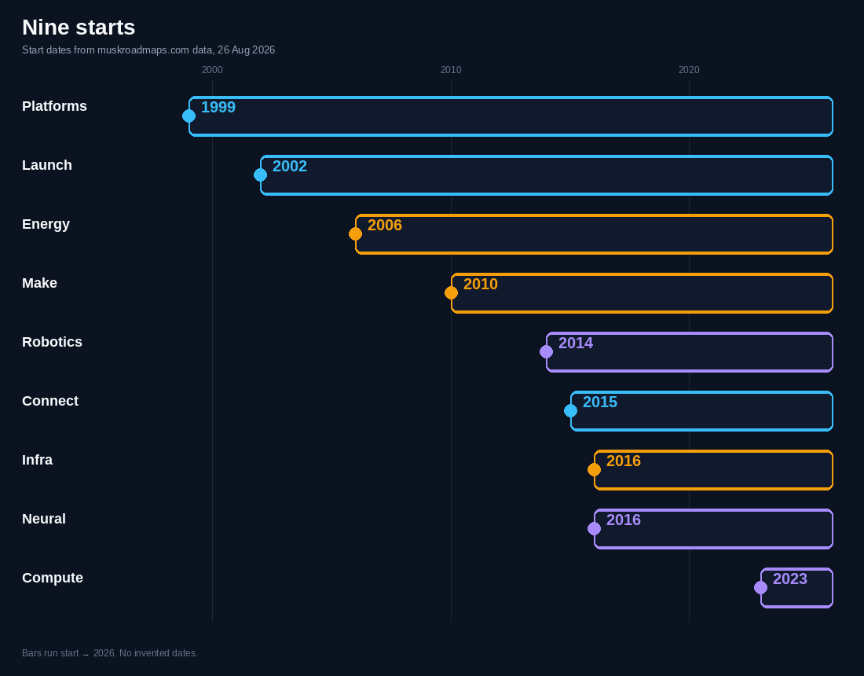
How to read this
Public sources. Engineering, not politics. Photo + start years.
Factories
Wikimedia Commons
muskroadmaps.com · not affiliated
engineering, not politics

Slide 4
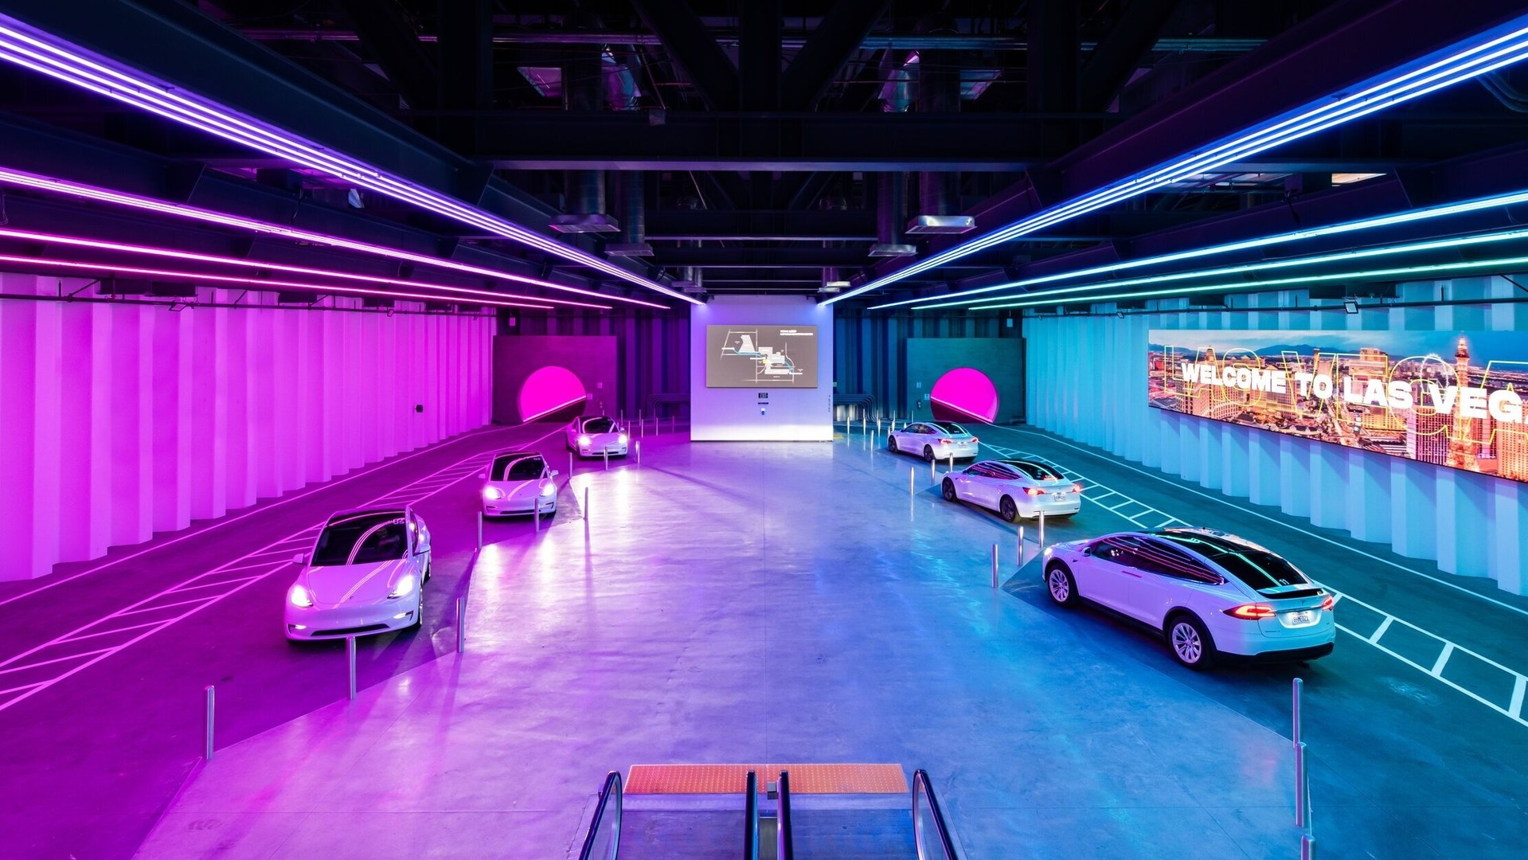
Ground & motor
Infra
10× tunneling cost reduction via continuous boring
The Boring Company
muskroadmaps.com · not affiliated
engineering, not politics

Slide 5
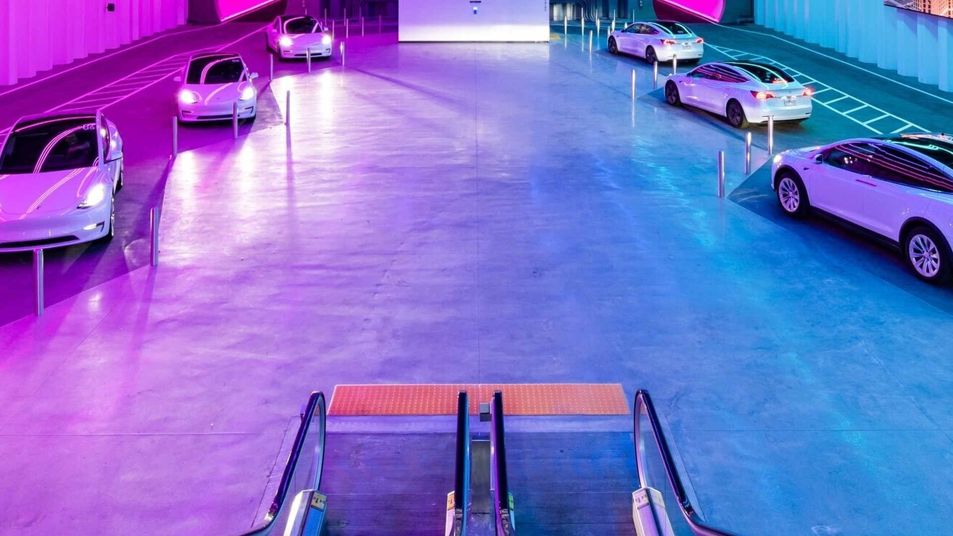
Ground & motor
Infra · vision
VISION
10×
10× tunneling cost reduction via continuous boring. Make tunneling a manufactured product: faster TBM cycles (Prufrock), modular tunnel segments, and standardized station interfaces — capex per meter as the primary metric.
GOAL · tunneling cost reduction
Stated goal, not a measured KPI · muskroadmaps.com, 26 Aug 2026
NOW
Vegas Convention Loop operational; Prufrock TBM iterations.
END
3D transport: underground highways that decongest cities — dig lots of holes.
The Boring Company
muskroadmaps.com · not affiliated
engineering, not politics

Slide 6
Ground & motor
Infra · now
START
NOW
2016-12
Vegas Convention Loop operational; Prufrock TBM iterations.
The Boring Company
WHY IT MATTERS
Cheaper meters so cities can tunnel.
muskroadmaps.com · not affiliated
engineering, not politics

Slide 7
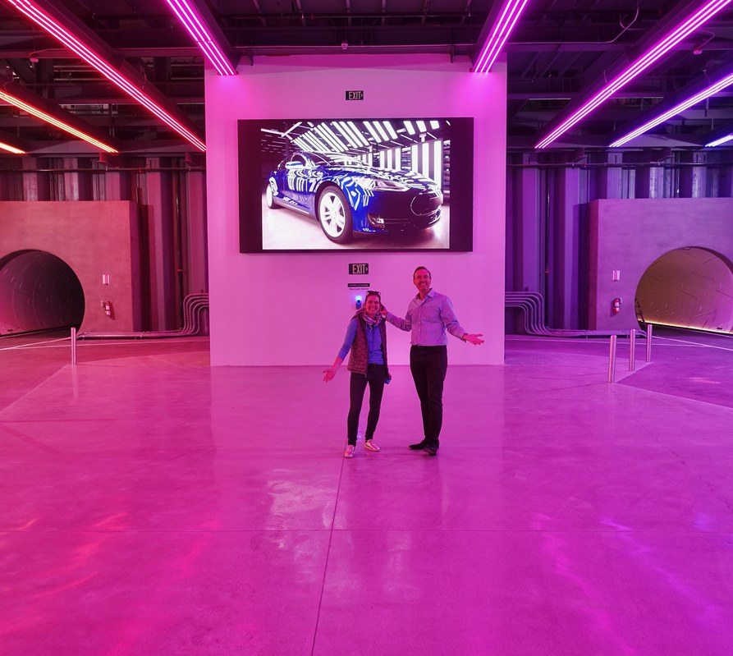

Infra · factories
Infra
Loop station · Vegas
Loop tunnel
Steve Jurvetson
The Boring Company
muskroadmaps.com · not affiliated
engineering, not politics

Slide 8
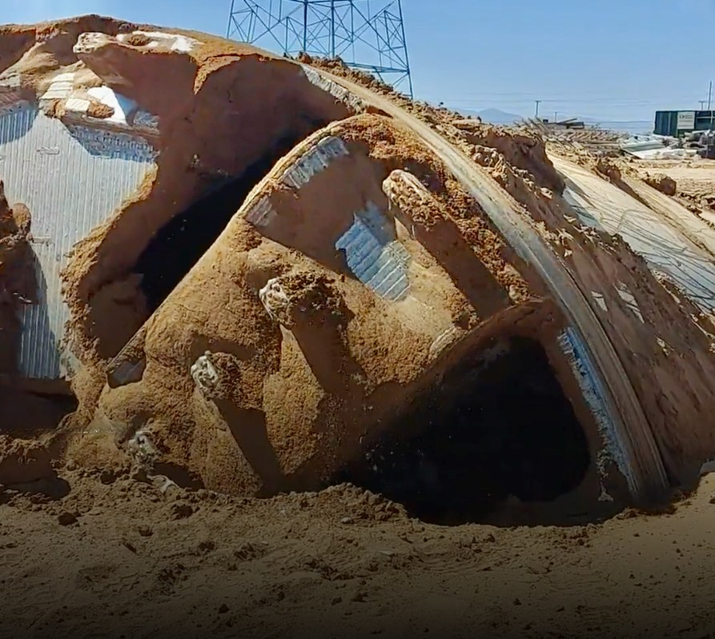
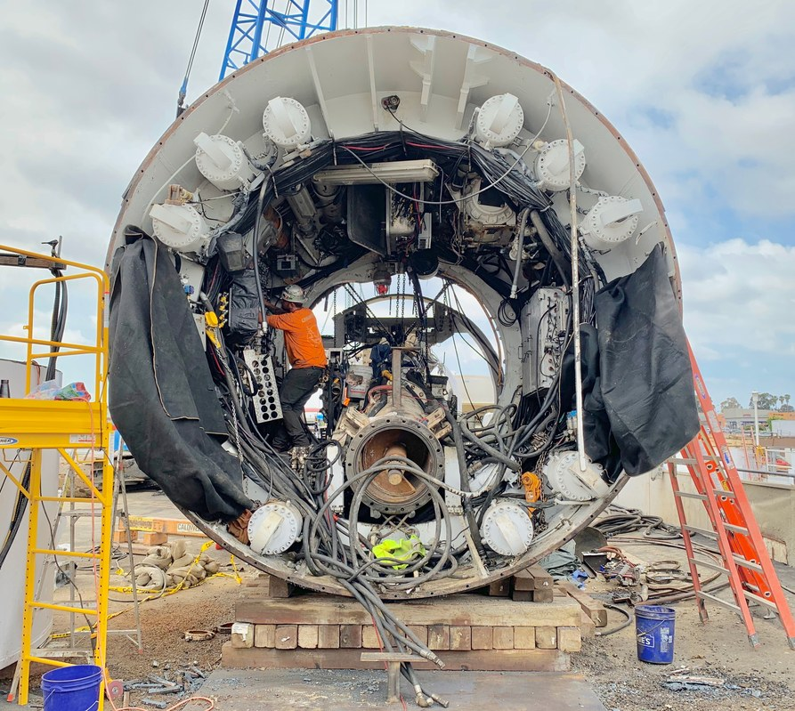
Infra · products
Infra
Prufrock TBM
Boring Company TBM
Steve Jurvetson
Steve Jurvetson
muskroadmaps.com · not affiliated
engineering, not politics

Slide 9
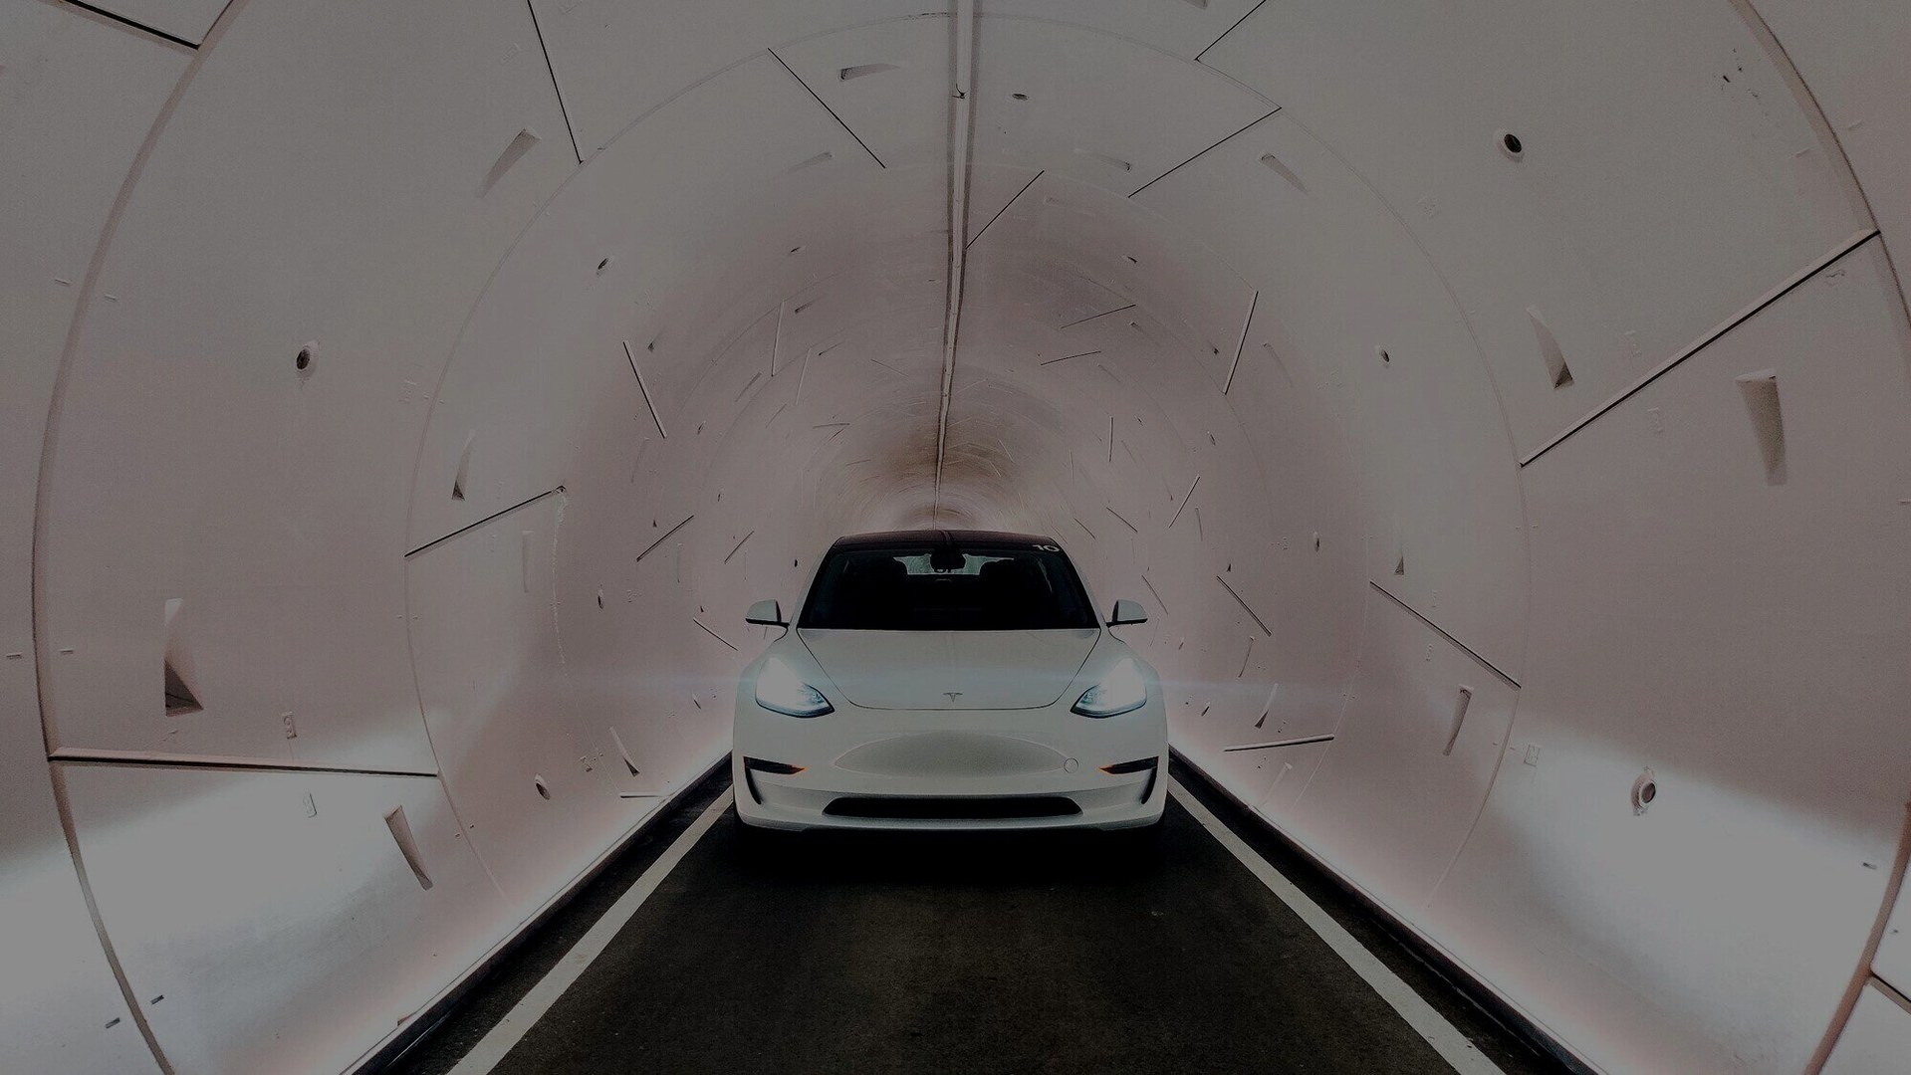
Next
Infra · next
Prufrock-4 — cheaper meters, so cities can actually tunnel
Vegas Loop expansion — more stations, less surface traffic
10×
3D urban transport — a second street grid underground
GOAL · tunneling cost reduction
Stated goal, not a measured KPI · muskroadmaps.com, 26 Aug 2026
The Boring Company
muskroadmaps.com · not affiliated
engineering, not politics

Slide 10
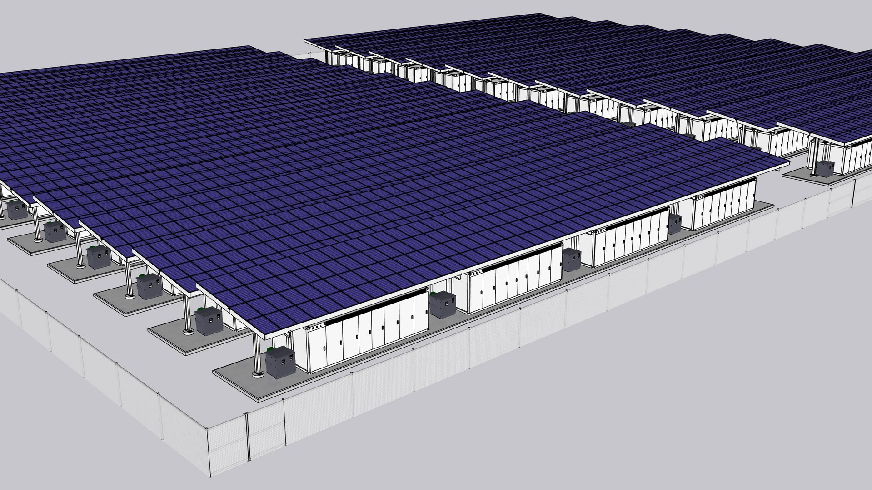
Ground & motor
Energy
Mine-to-grid storage at utility scale
Wikideas1
muskroadmaps.com · not affiliated
engineering, not politics

Slide 11
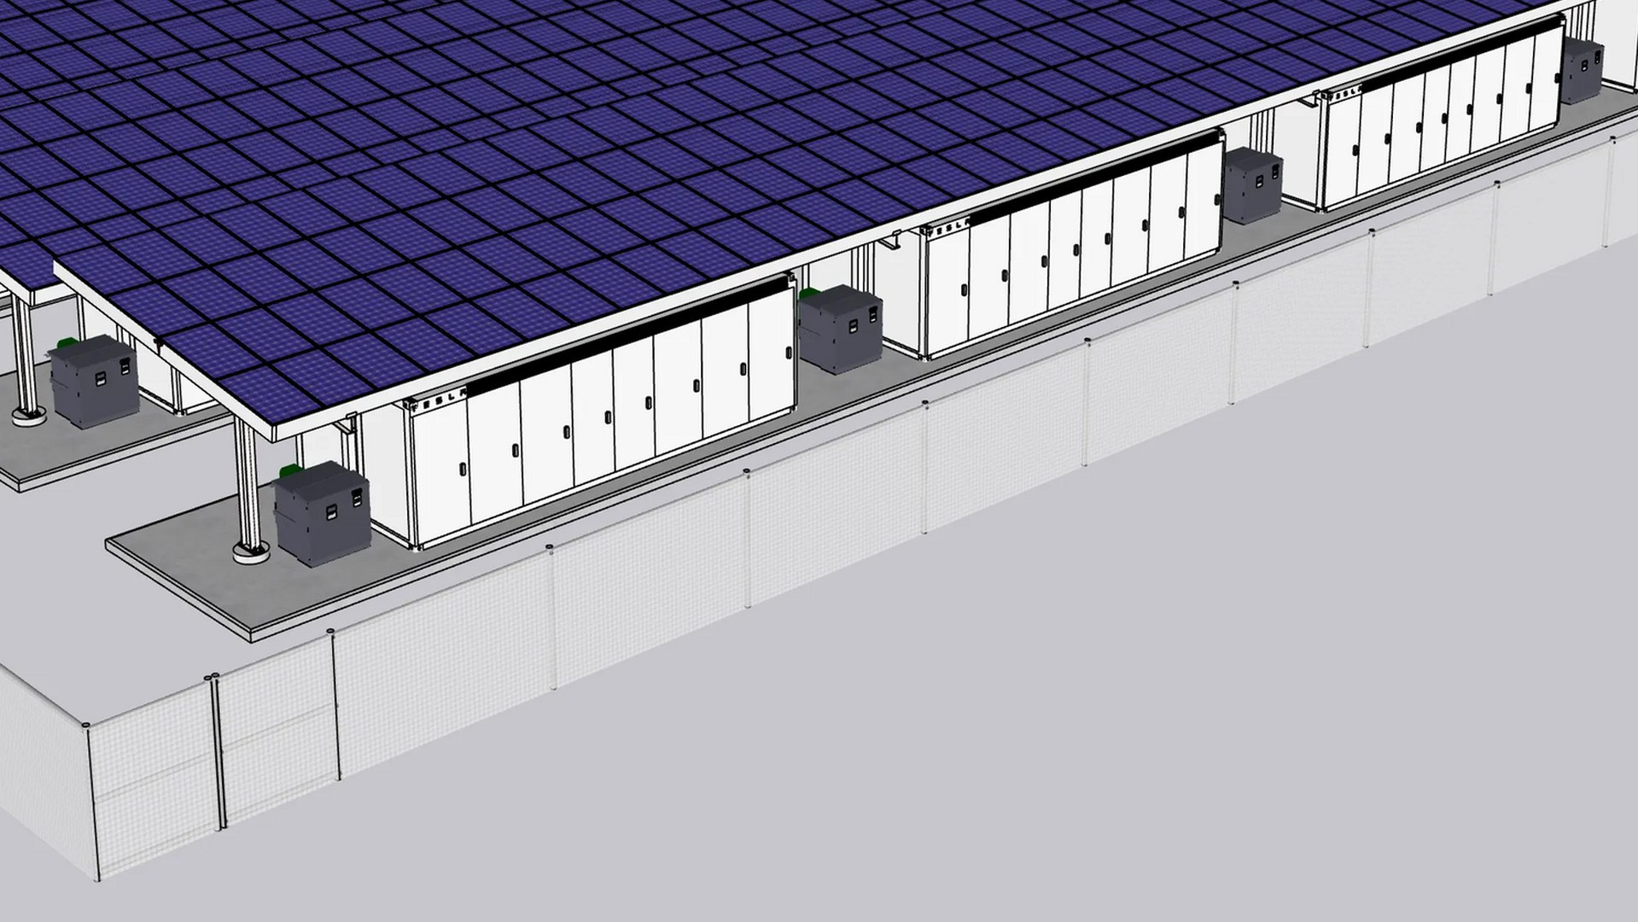
Ground & motor
Energy · vision
VISION
Mine-to-grid storage at utility scale. Own the chain from lithium refining through cell, pack, and grid dispatch (Megapack/Megablock) so energy density and $/kWh become controllable design parameters, not supplier.
NOW
Megapack and Megablock deployed globally; Powerwall v3.
END
Sustainable world energy: terawatt-scale storage and generation replacing the grid.
Wikideas1
muskroadmaps.com · not affiliated
engineering, not politics

Slide 12
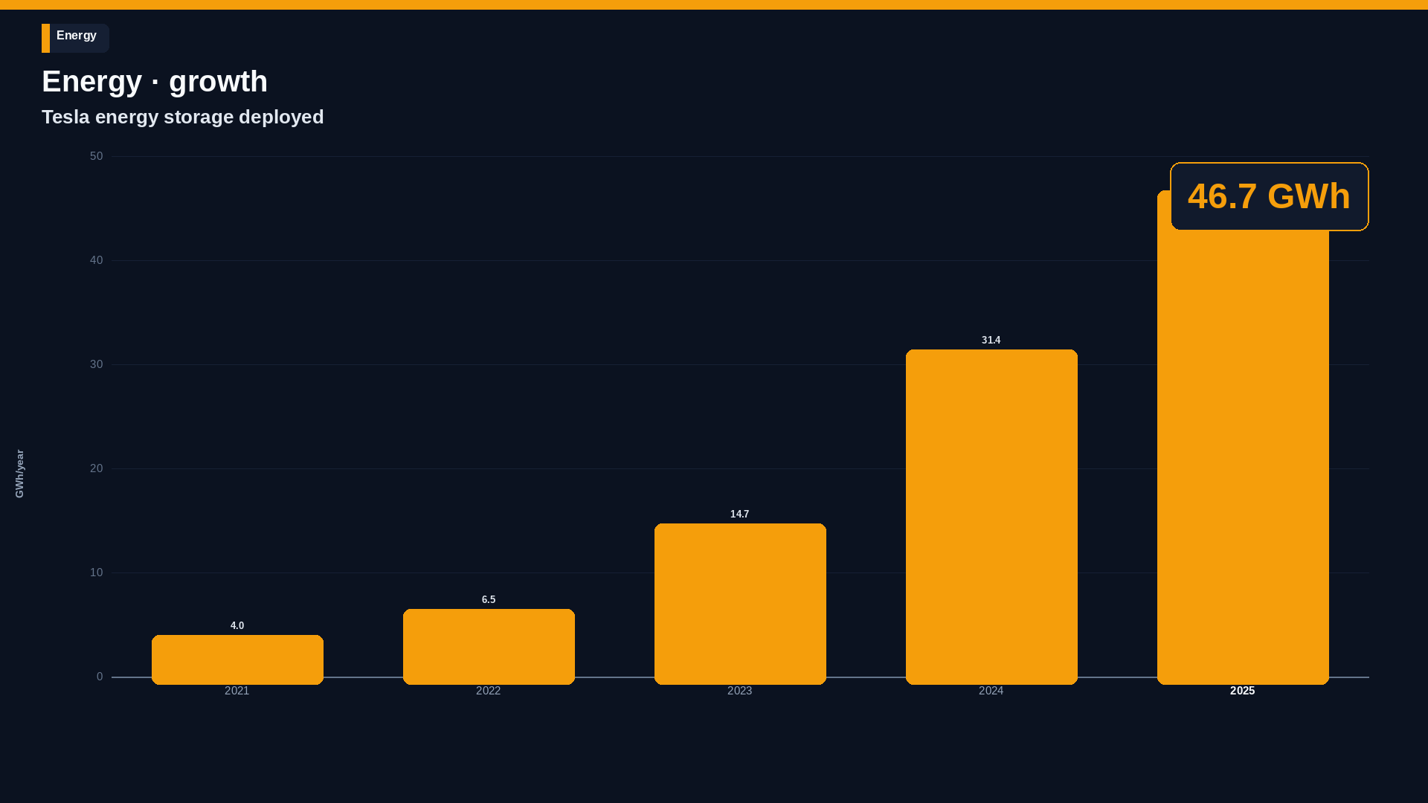
Tesla Q4 2025 Update.
muskroadmaps.com · not affiliated
engineering, not politics

Slide 13
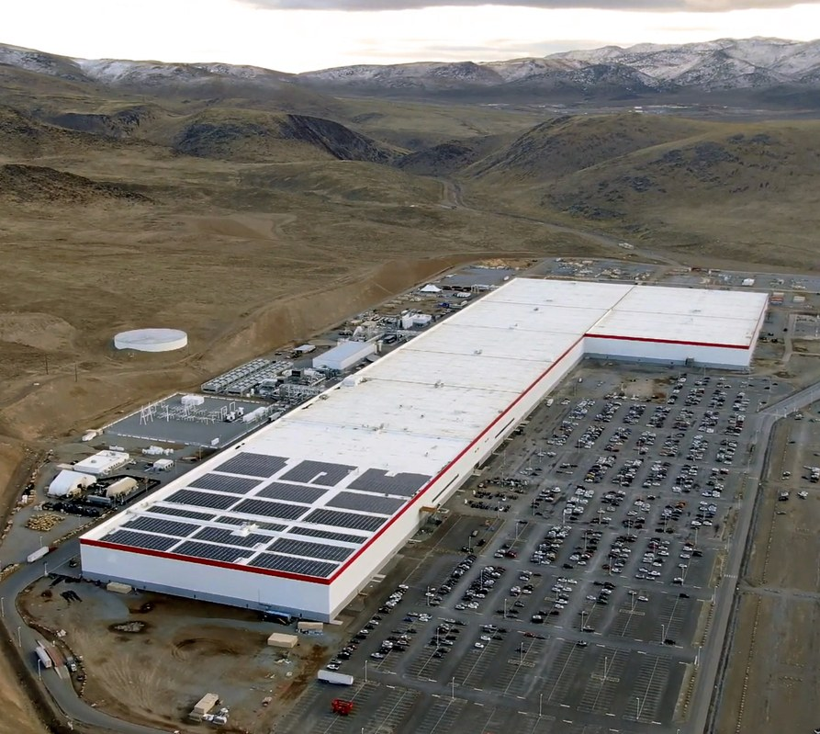
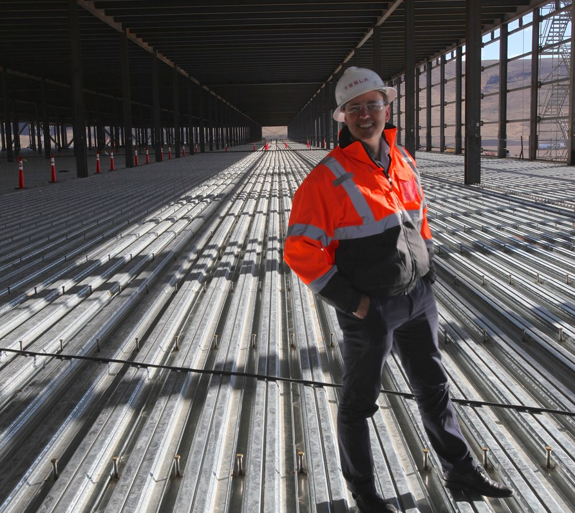
Energy · factories
Energy
Giga Nevada · Sparks
Giga Nevada · construction
Wikimedia Commons
Steve Jurvetson
muskroadmaps.com · not affiliated
engineering, not politics

Slide 14
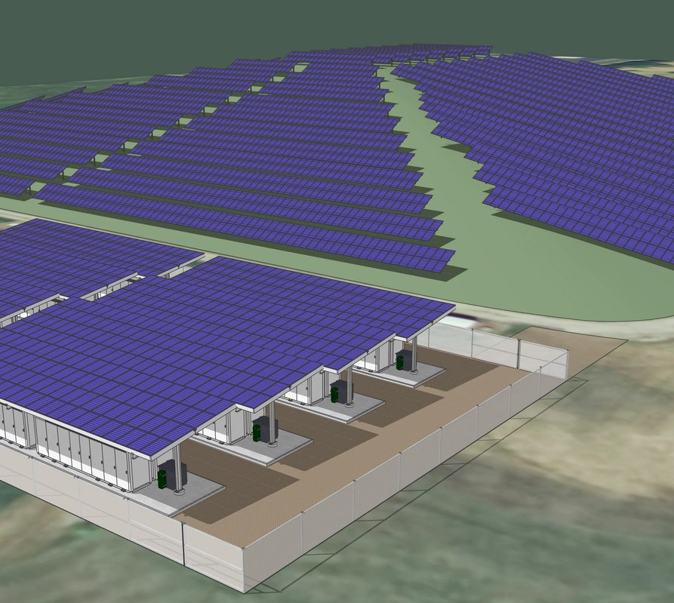
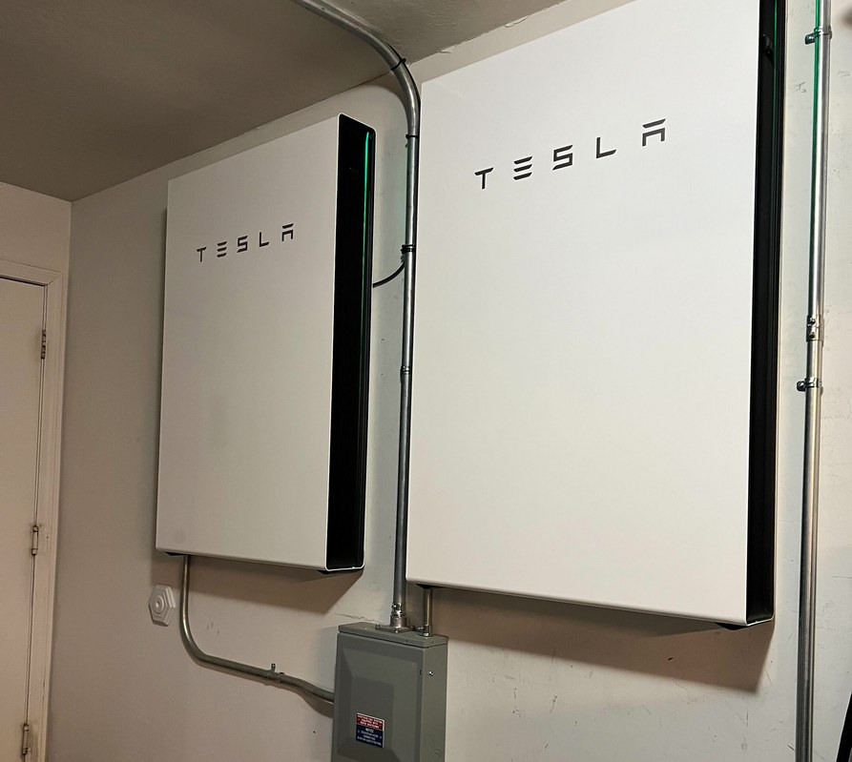
Energy · products
Energy
Megapack + solar
Powerwall 3
Wikideas1
Wikimedia Commons
muskroadmaps.com · not affiliated
engineering, not politics

Slide 15
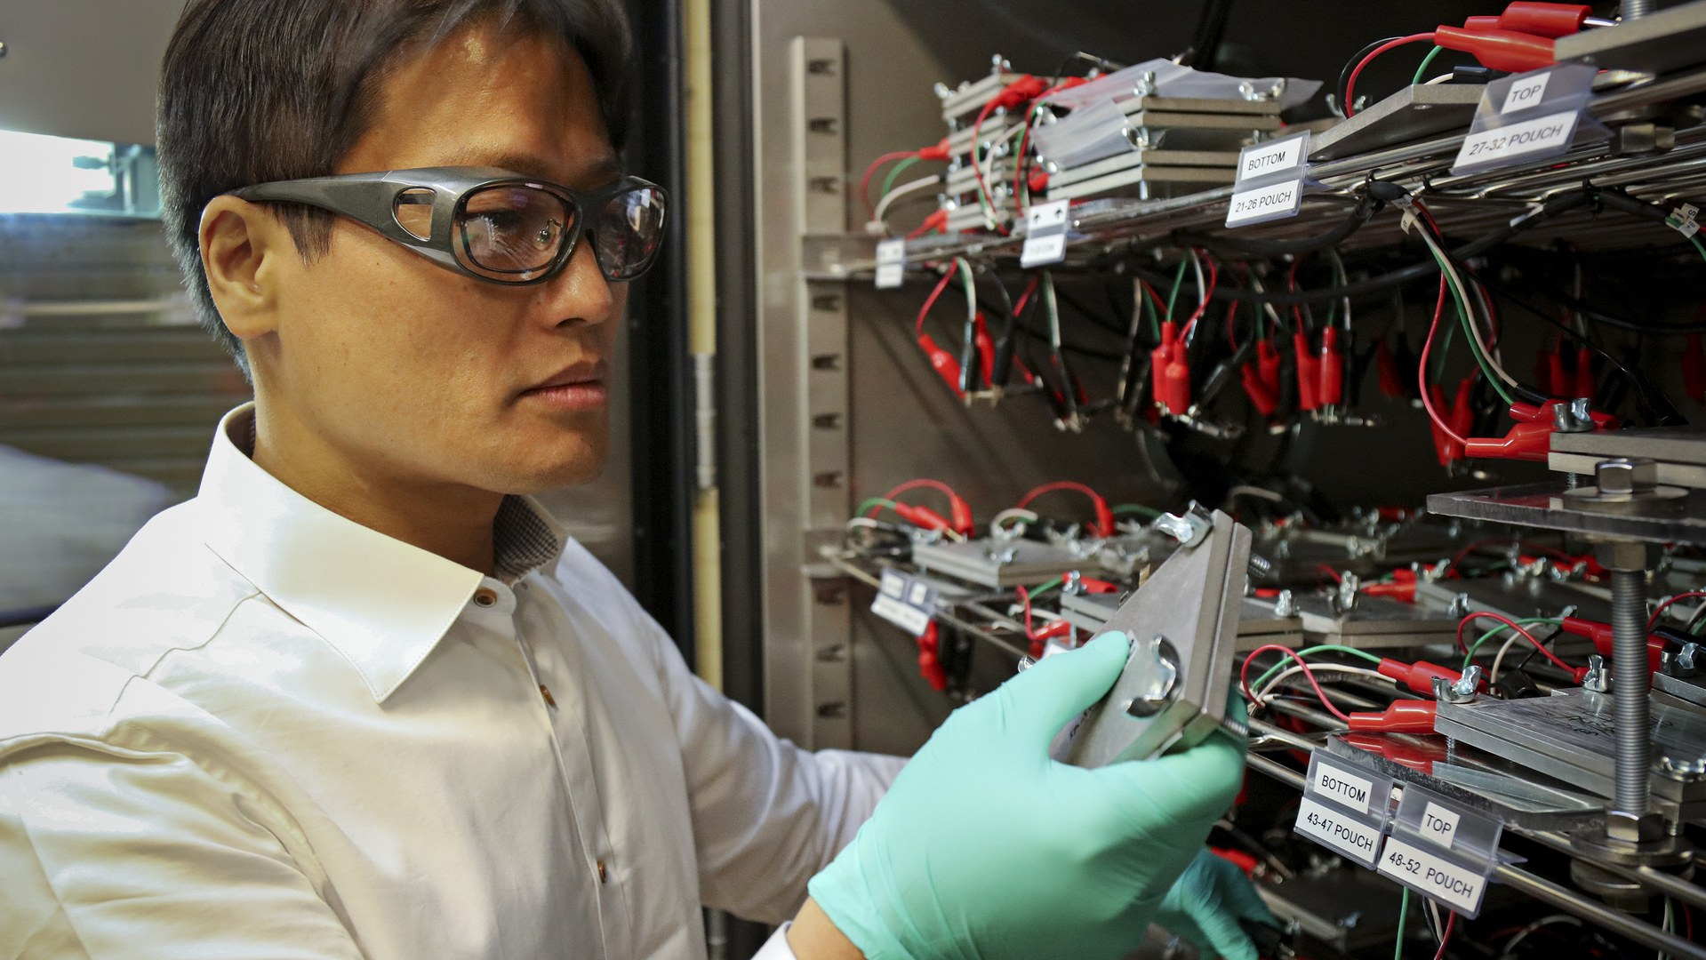
Next
Energy · next
Denser 4680 cells — more range, lower pack cost
Megablock bundles — utilities plug storage in as one unit
TWh-scale grid — firm power for AI campuses and cities
Oak Ridge National Laboratory
muskroadmaps.com · not affiliated
engineering, not politics

Slide 16
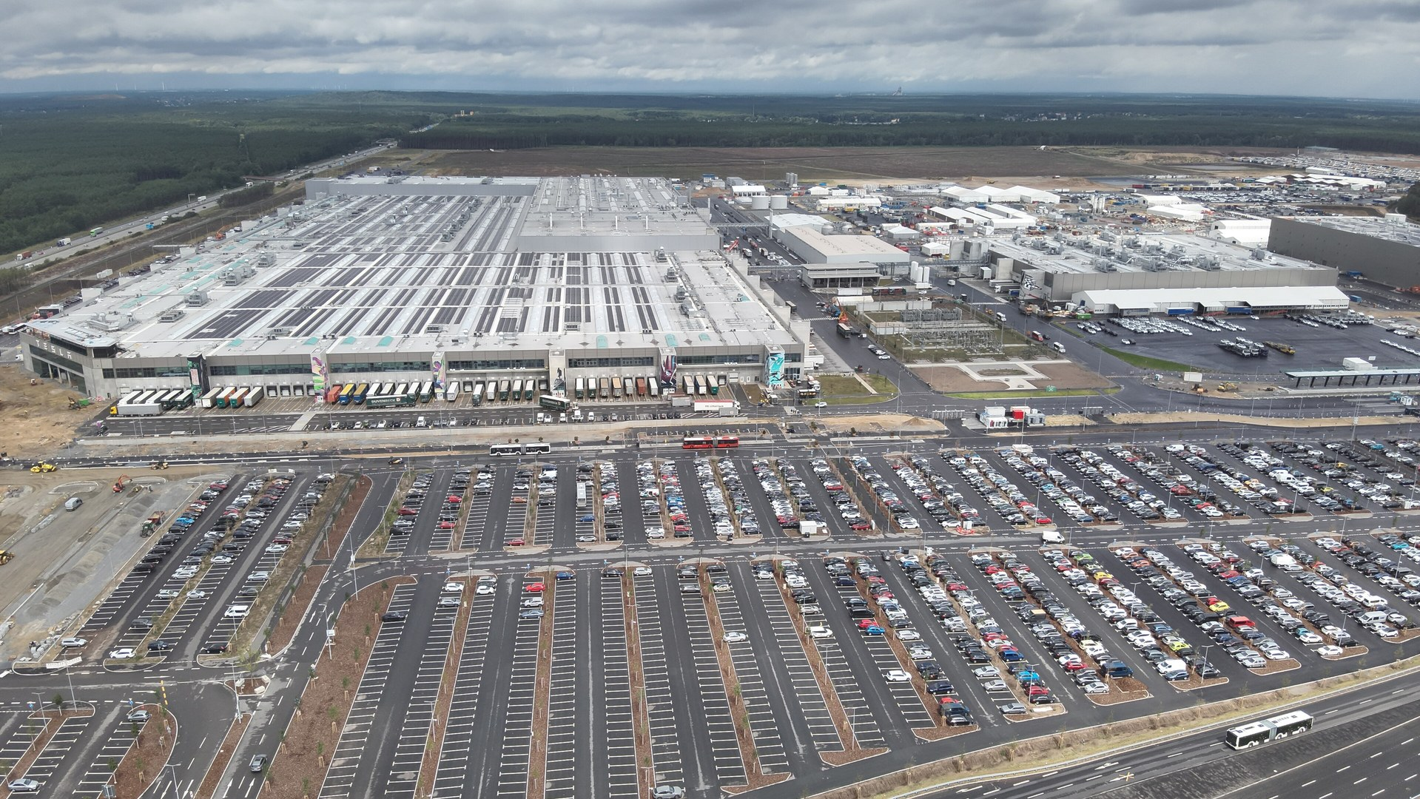
Ground & motor
Make
Copyable factory OS — design change to line in days
Michael Wolf
muskroadmaps.com · not affiliated
engineering, not politics

Slide 17
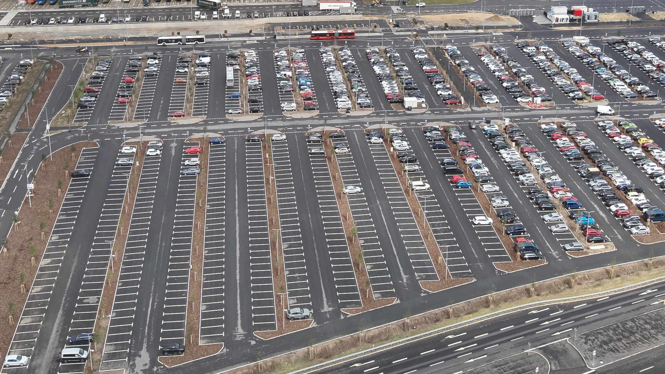
Ground & motor
Make · vision
VISION
Copyable factory OS — design change to line in days. Standardize gigafactory as a repeatable product: giga-casting, rapid line retool, 4680/semis integration — same playbook for vehicles, rockets, chips, and robots.
NOW
Gigafactory blueprint: giga-casting, 4680 lines, Optimus on the line; Starbase Starship production.
END
Extreme manufacturing velocity: every Giga is a copyable product — cars, rockets, chips, robots on one philosophy.
Michael Wolf
muskroadmaps.com · not affiliated
engineering, not politics

Slide 18
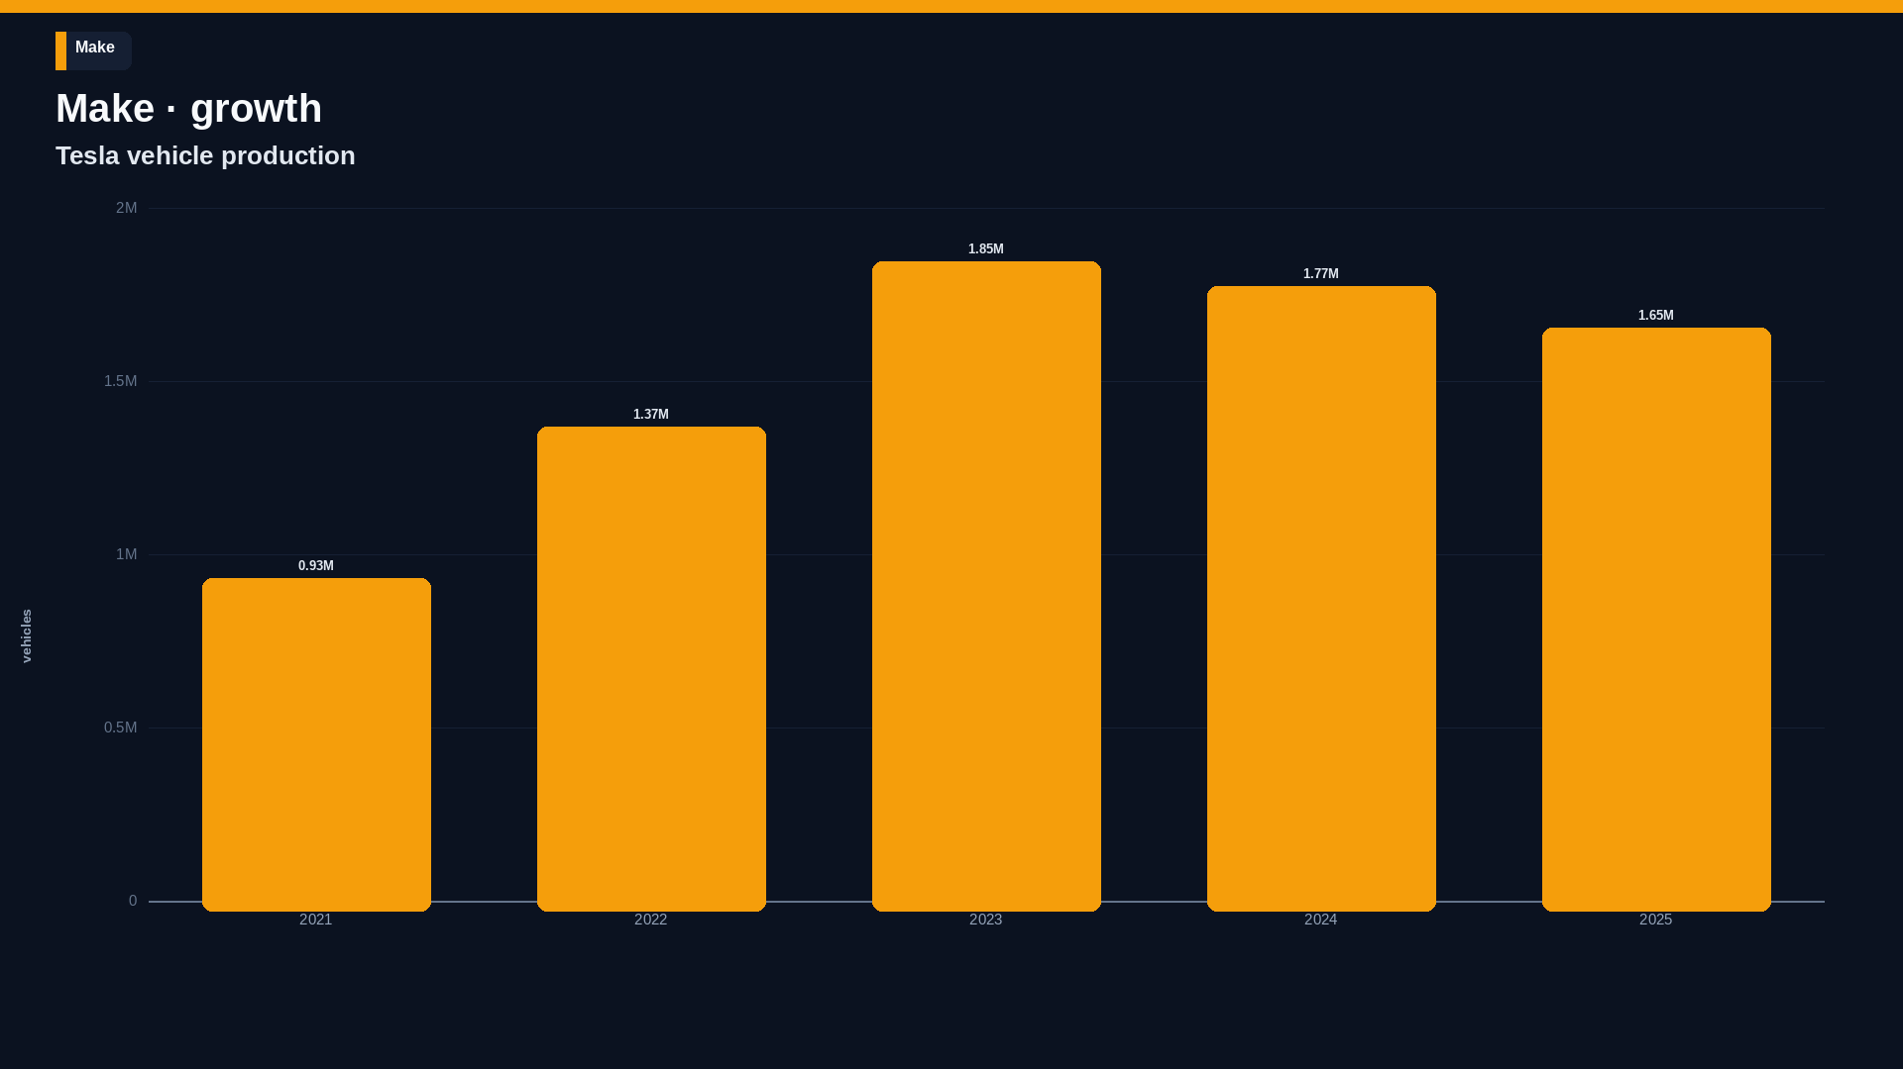
Tesla Q4 2025 Update. 2024–2025 declined; the chart shows that.
muskroadmaps.com · not affiliated
engineering, not politics

Slide 19
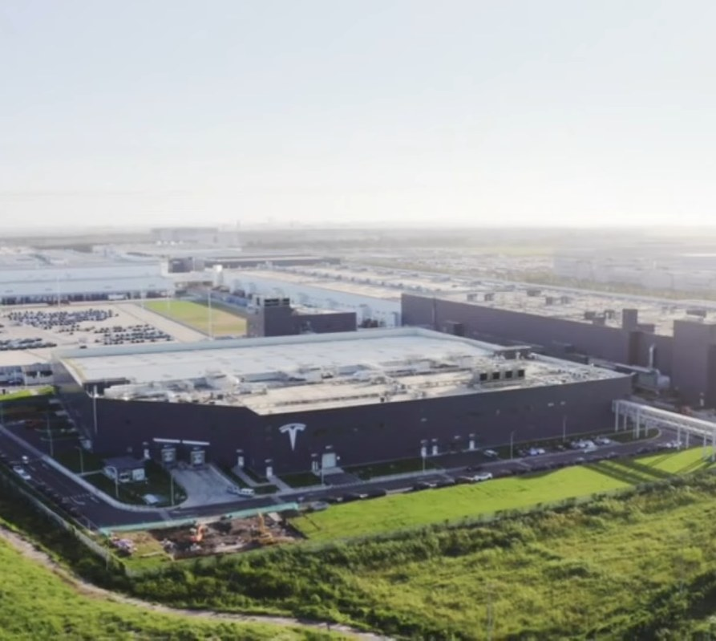
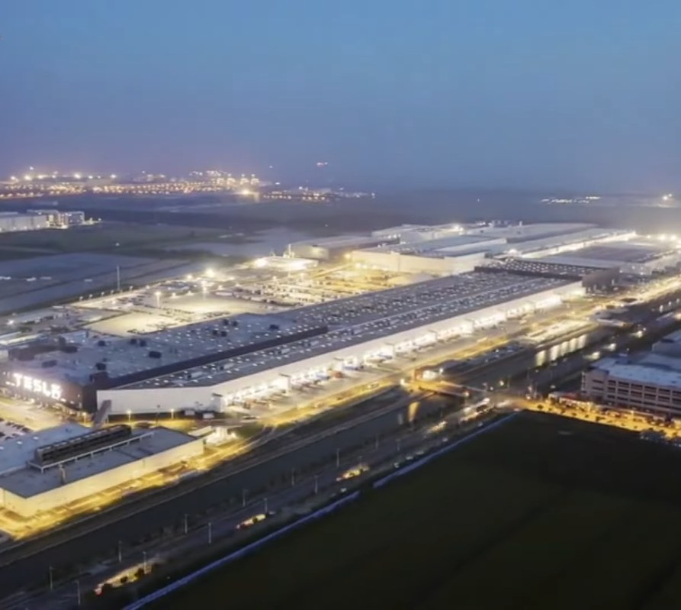
Make · factories
Make
Giga Shanghai
Giga Shanghai · night
China News Service
China News Service
muskroadmaps.com · not affiliated
engineering, not politics

Slide 20
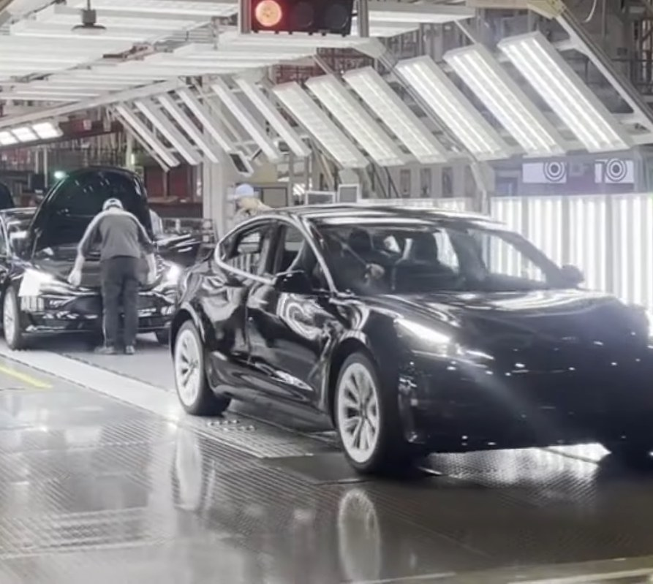
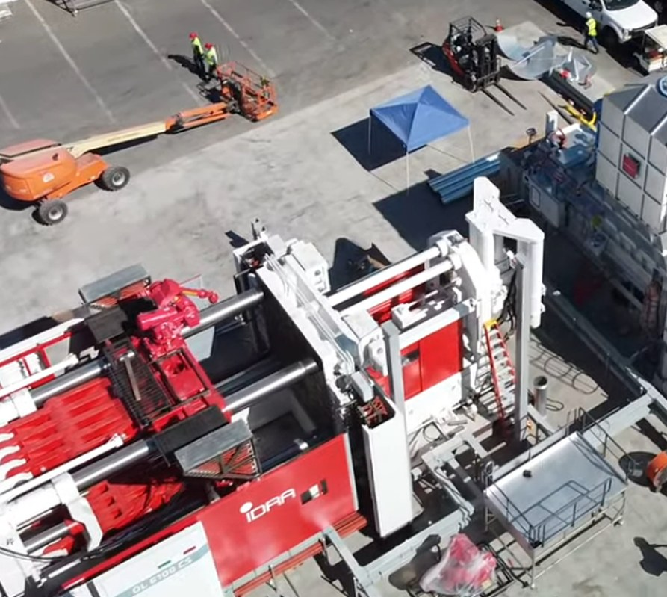
Make · products
Make
Giga Shanghai · line
Giga Press · Fremont
China News Service
Gabeincal
muskroadmaps.com · not affiliated
engineering, not politics

Slide 21
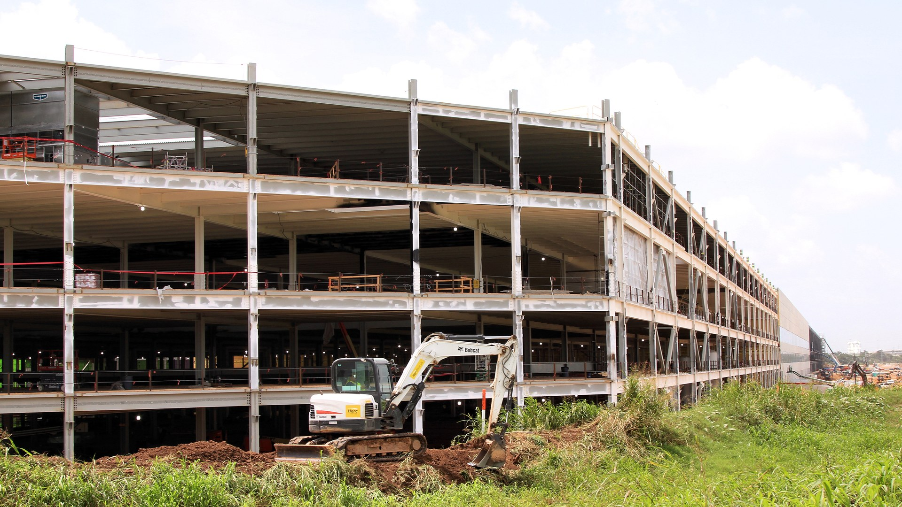
Next
Make · next
Terafab phase-1 — own the chip supply, not just the cars
Optimus on the line — robots that build the next robots
Every Giga is a product — copy the factory, not just the car
Larry D. Moore
muskroadmaps.com · not affiliated
engineering, not politics

Slide 22
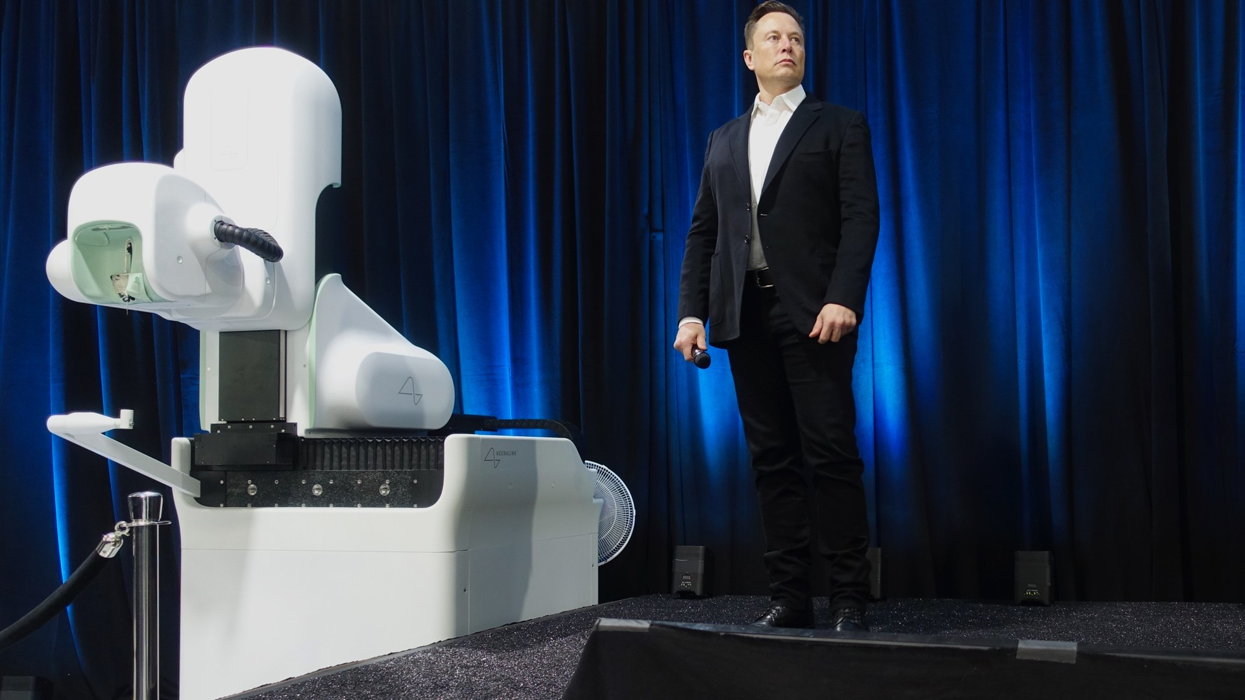
Intelligence & action
Neural
Clinical-grade BCI — implant, surgery, production
Steve Jurvetson
muskroadmaps.com · not affiliated
engineering, not politics

Slide 23
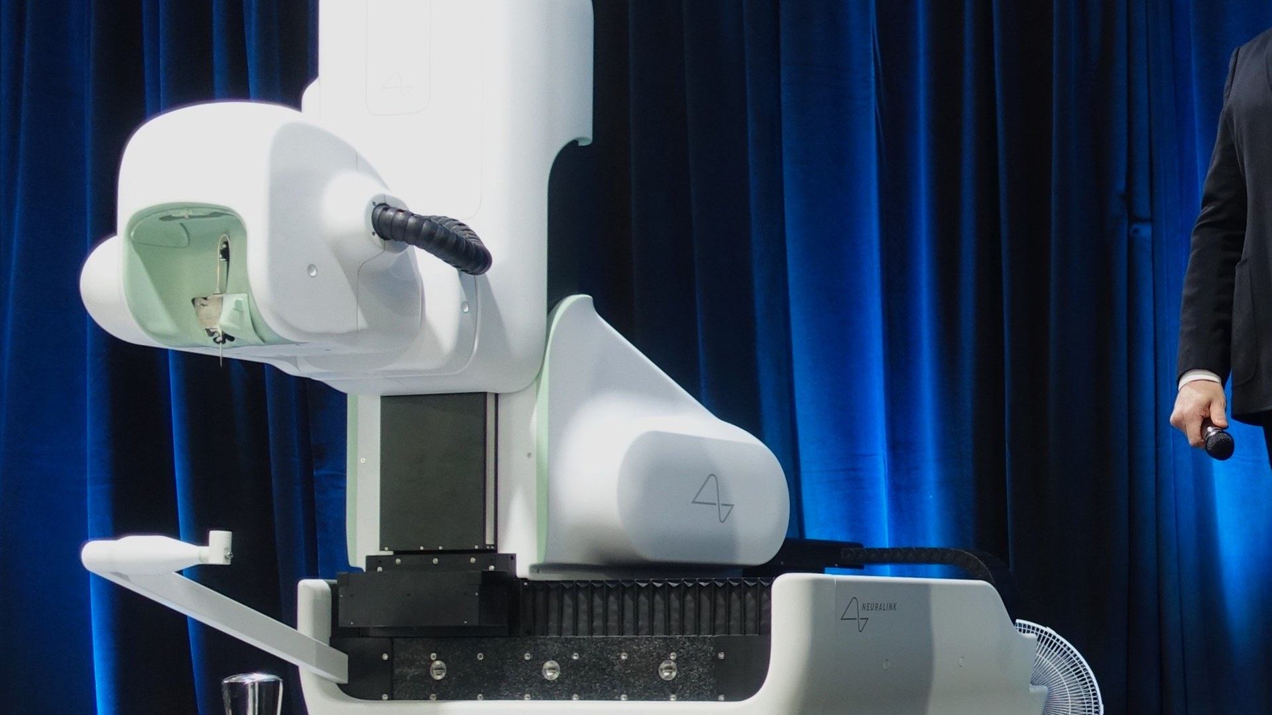
Intelligence & action
Neural · vision
VISION
Clinical-grade BCI — implant, surgery, production. Deliver a regulated implant platform: high-channel electrodes, robot-assisted surgery (R1), and multi-site manufacturing (Fremont R&D, Del Valle production, South SF lab) — FDA.
NOW
FDA Breakthrough Device; 21+ trial participants (early 2025).
END
Human–AI symbiosis — BCI as the default interface after phones; neurological conditions treated at scale.
Steve Jurvetson
muskroadmaps.com · not affiliated
engineering, not politics

Slide 24
Intelligence & action
Neural · now
START
NOW
2016-07
FDA Breakthrough Device; 21+ trial participants (early 2025).
Neuralink
WHY IT MATTERS
Thought-to-text in human trials.
muskroadmaps.com · not affiliated
engineering, not politics

Slide 25
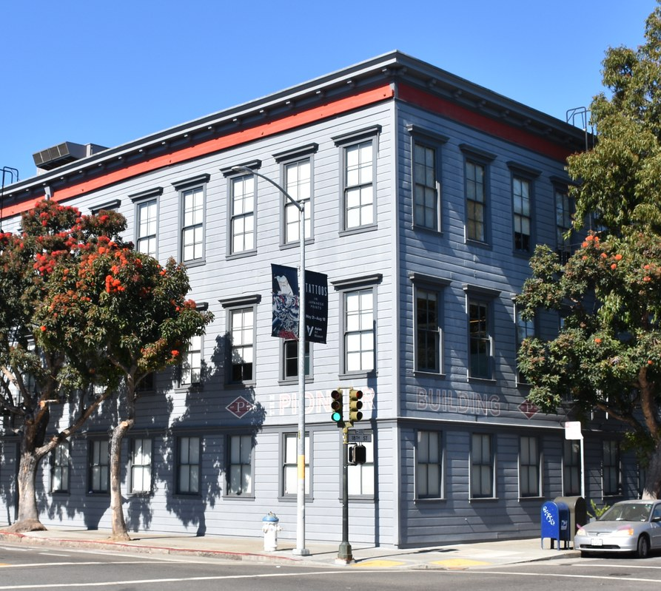
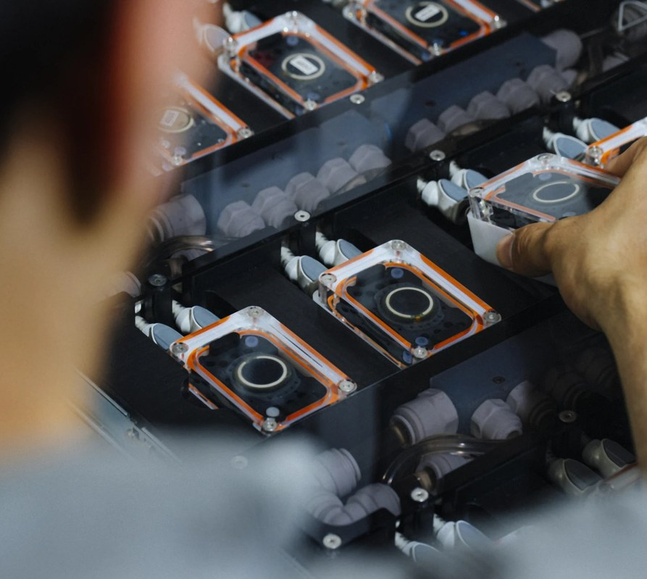
Neural · factories
Neural
Neuralink · Pioneer Building
Neuralink hardware
HaeB
Neuralink
muskroadmaps.com · not affiliated
engineering, not politics

Slide 26
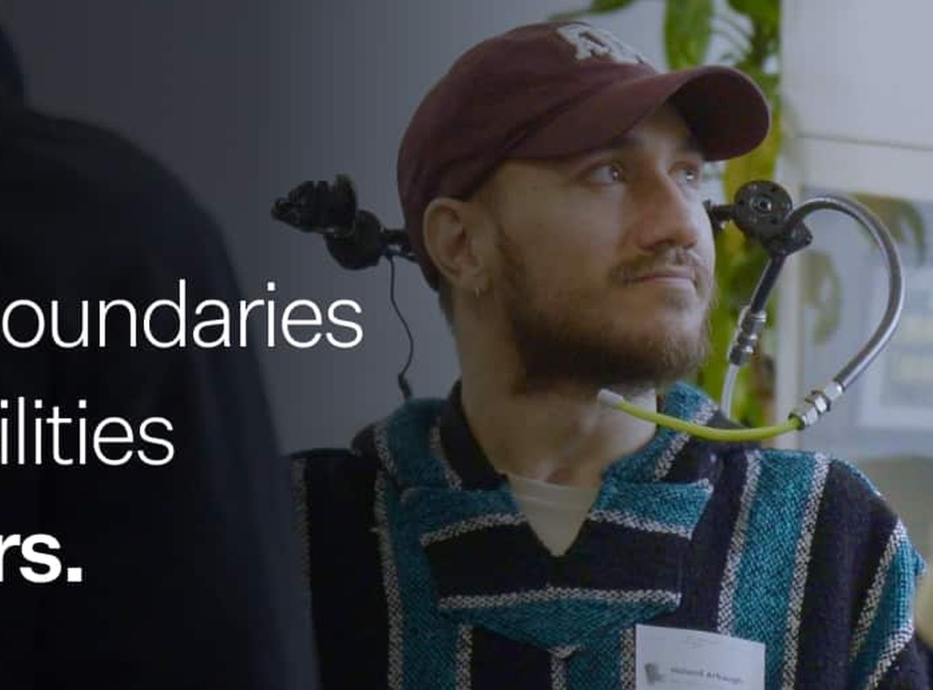
Neural · products
Neural
SOURCED
21+
trial participants
early 2025
Neuralink clinical program. Figure from muskroadmaps.com data, 26 Aug 2026.
Telepathy clinical program
Neuralink
muskroadmaps.com · not affiliated
engineering, not politics

Slide 27
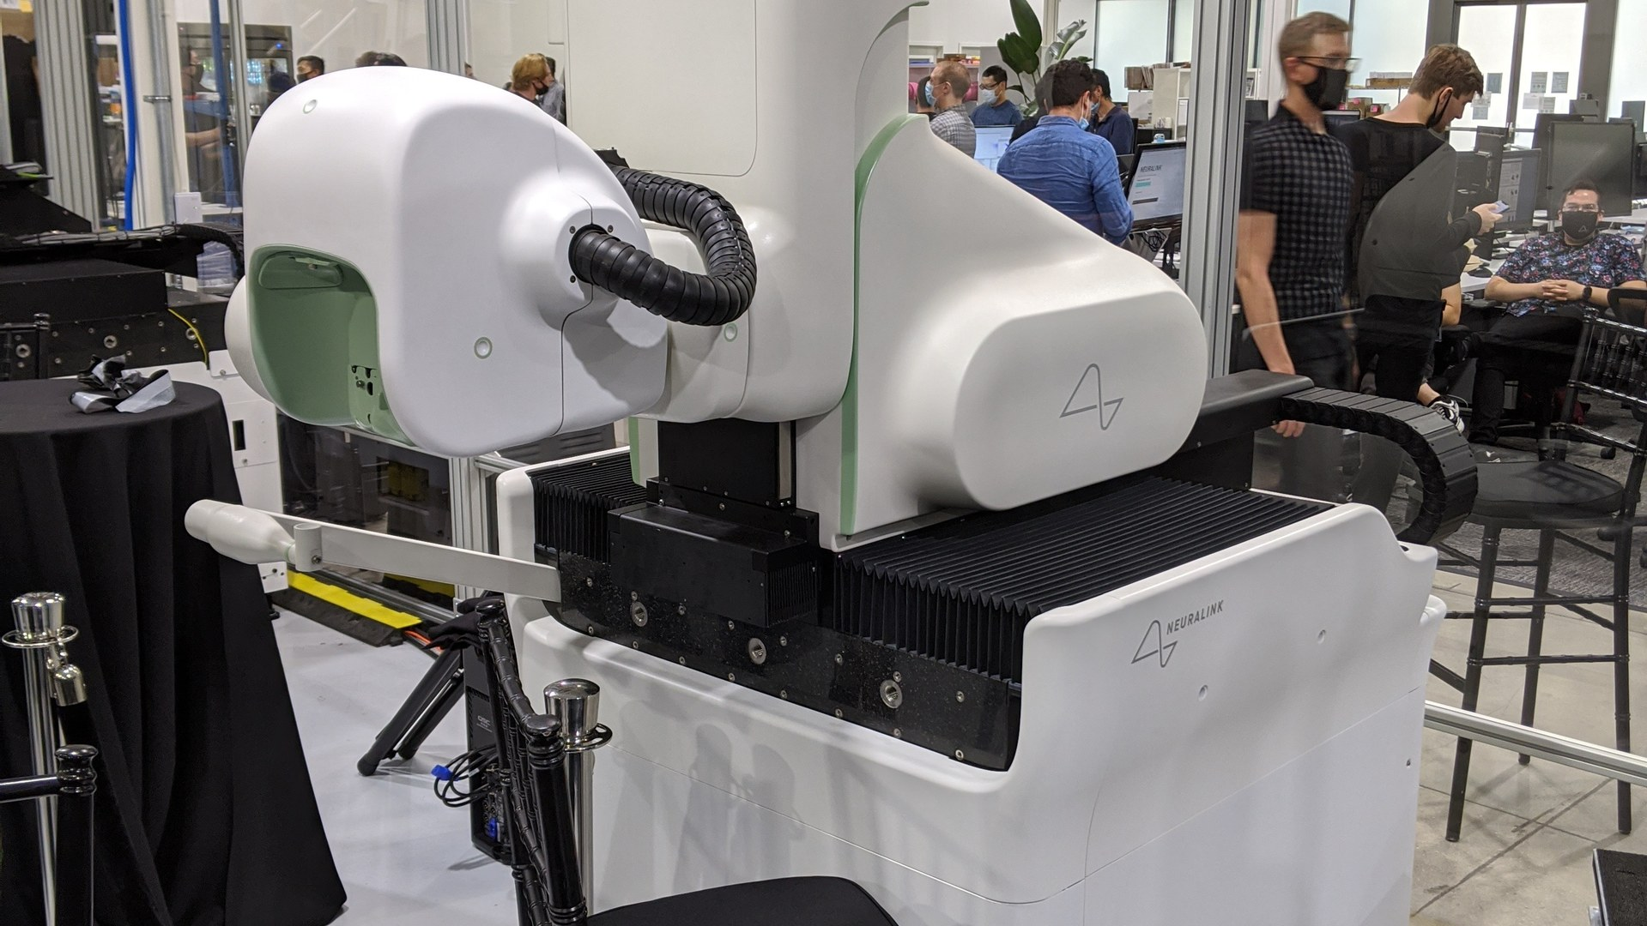
Next
Neural · next
N2 implant — more channels, so thought-to-text gets usable
Blindsight — restore vision through the implant
BCI after phones — a computer you don't hold
Leijurv
muskroadmaps.com · not affiliated
engineering, not politics

Slide 28
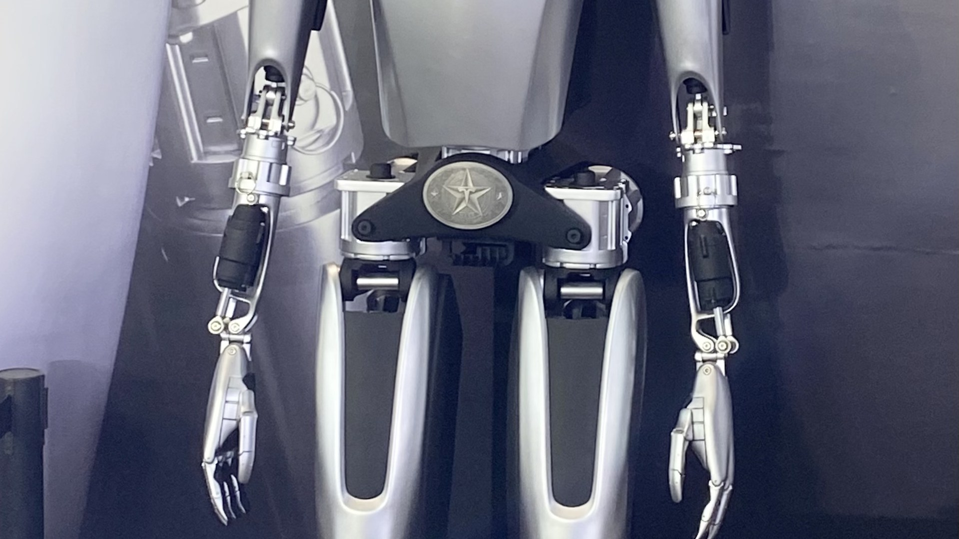
Intelligence & action
Robotics
Close sim-to-real — factory lines and autonomous fleets
Wikimedia Commons
muskroadmaps.com · not affiliated
engineering, not politics

Slide 29
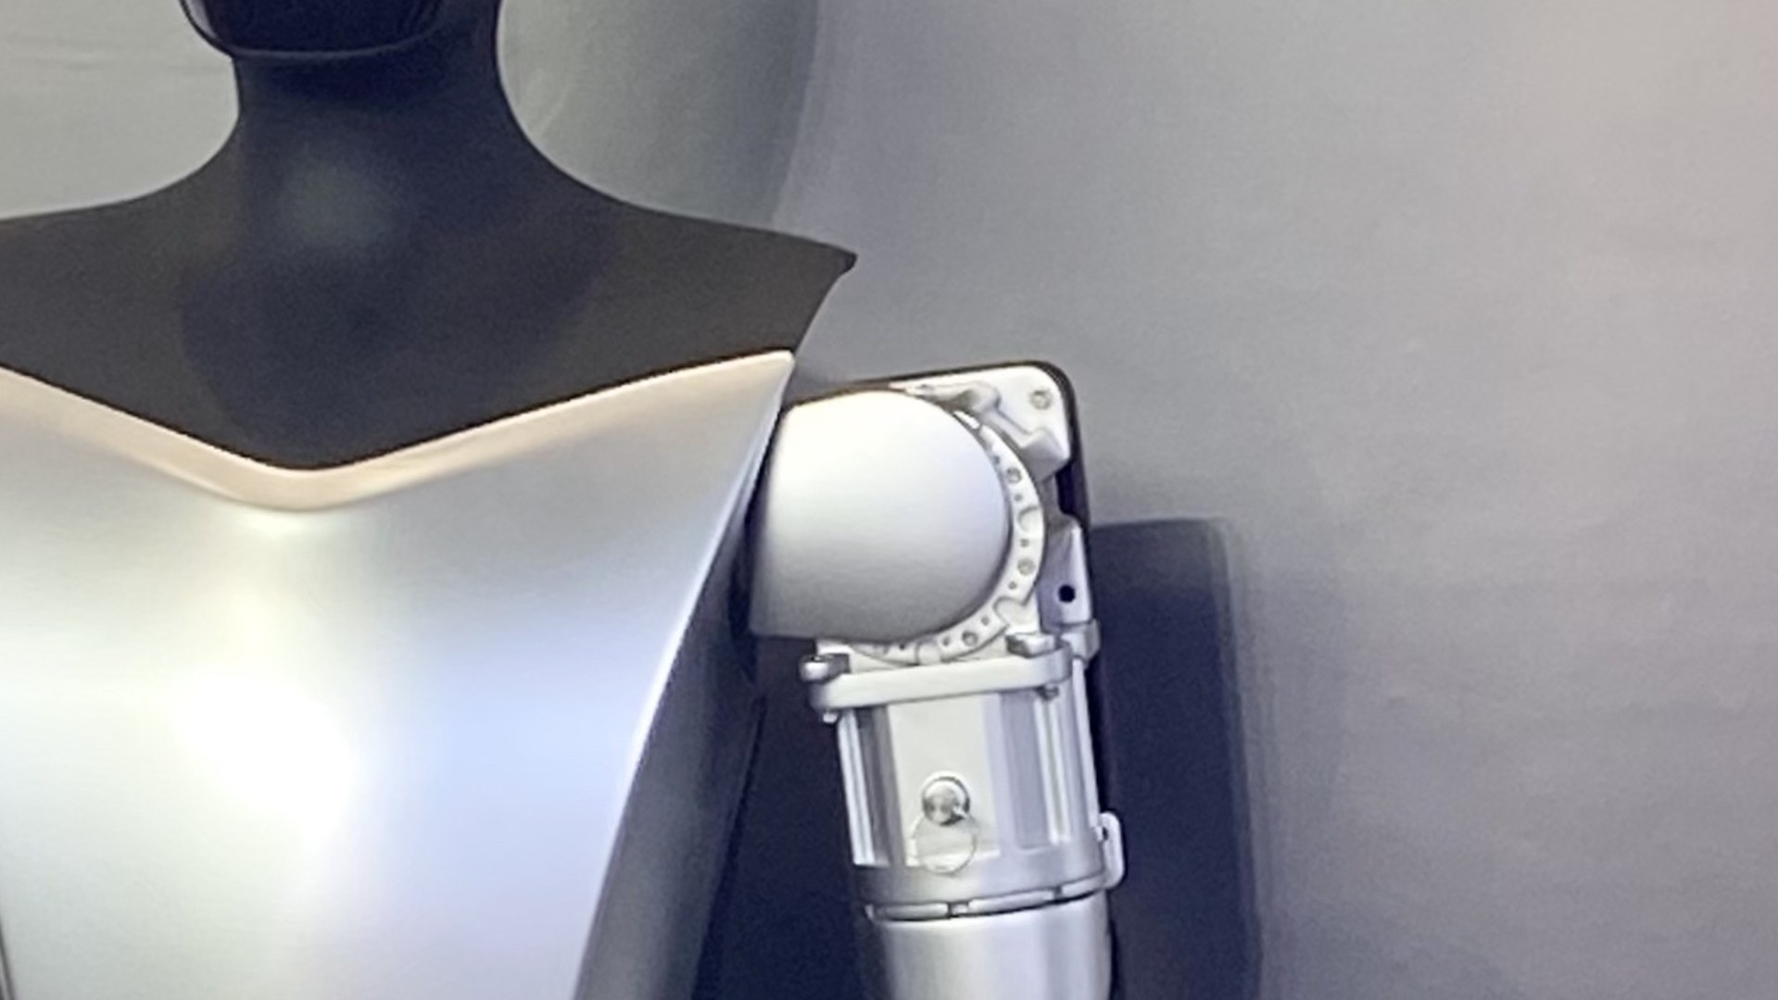
Intelligence & action
Robotics · vision
VISION
Close sim-to-real — factory lines and autonomous fleets. Ship perception, planning, and actuation as one deployable stack: factory automation (Optimus), supervised then unsupervised driving (FSD), and surgical robotics (R1) on shared.
NOW
Optimus Gen 2 demos; pilot lines at Giga Texas; FSD supervised rollout across US.
END
Physical AI workers: factories run largely autonomously; robotaxi network; humanoids in homes.
Wikimedia Commons
muskroadmaps.com · not affiliated
engineering, not politics

Slide 30
Intelligence & action
Robotics · now
START
NOW
2014-10
Optimus Gen 2 demos; FSD supervised in the US.
Tesla
WHY IT MATTERS
Factory hands and unsupervised driving still ahead.
muskroadmaps.com · not affiliated
engineering, not politics

Slide 31
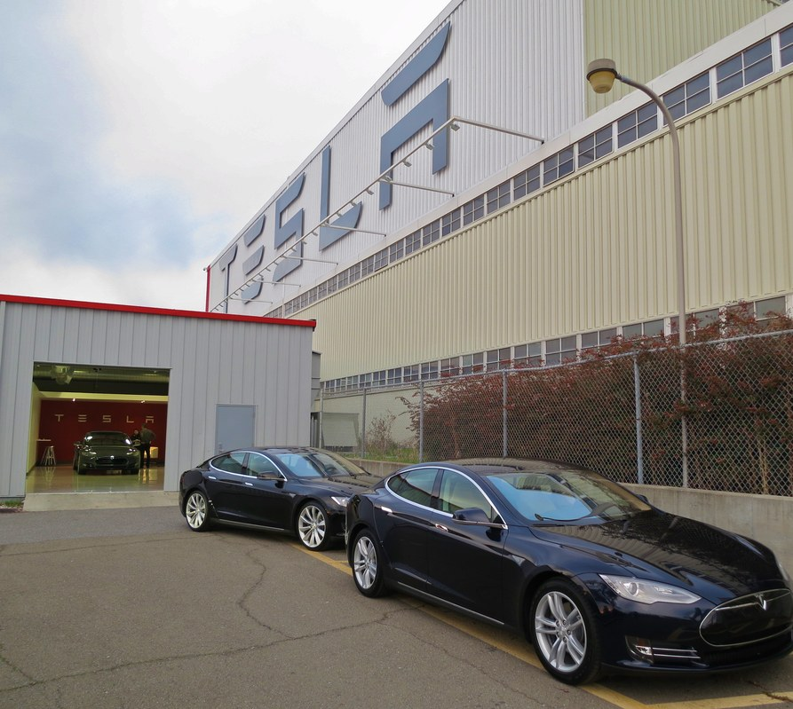
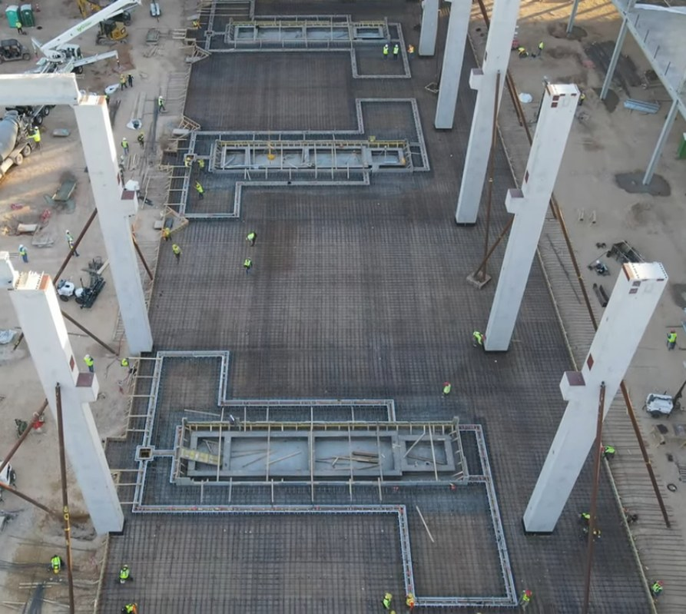
Robotics · factories
Robotics
Fremont factory
Giga Press foundations · Texas
Steve Jurvetson
Gabeincal
muskroadmaps.com · not affiliated
engineering, not politics

Slide 32
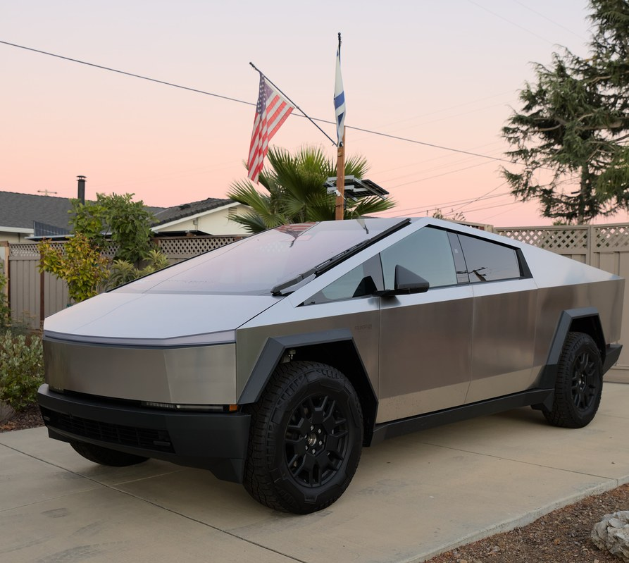
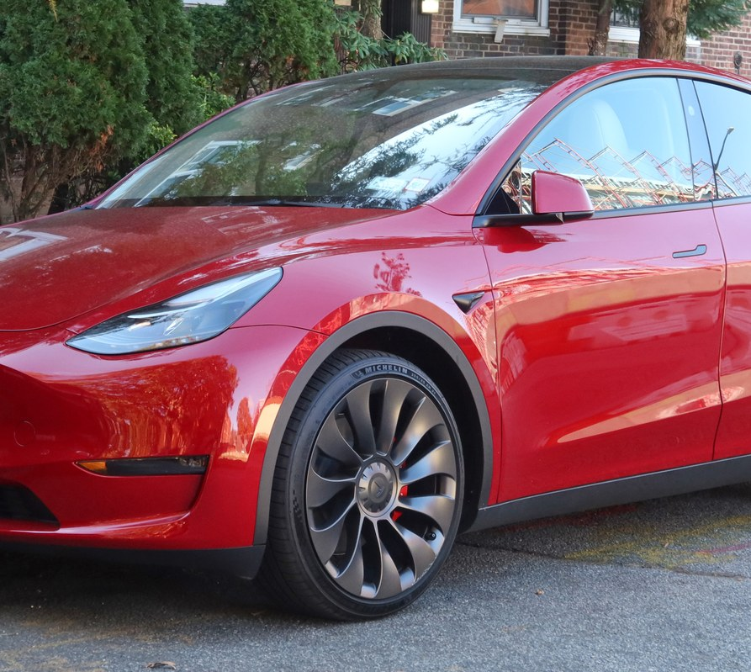
Robotics · products
Robotics
Cybertruck
Model Y
dllu
Kevauto
muskroadmaps.com · not affiliated
engineering, not politics

Slide 33
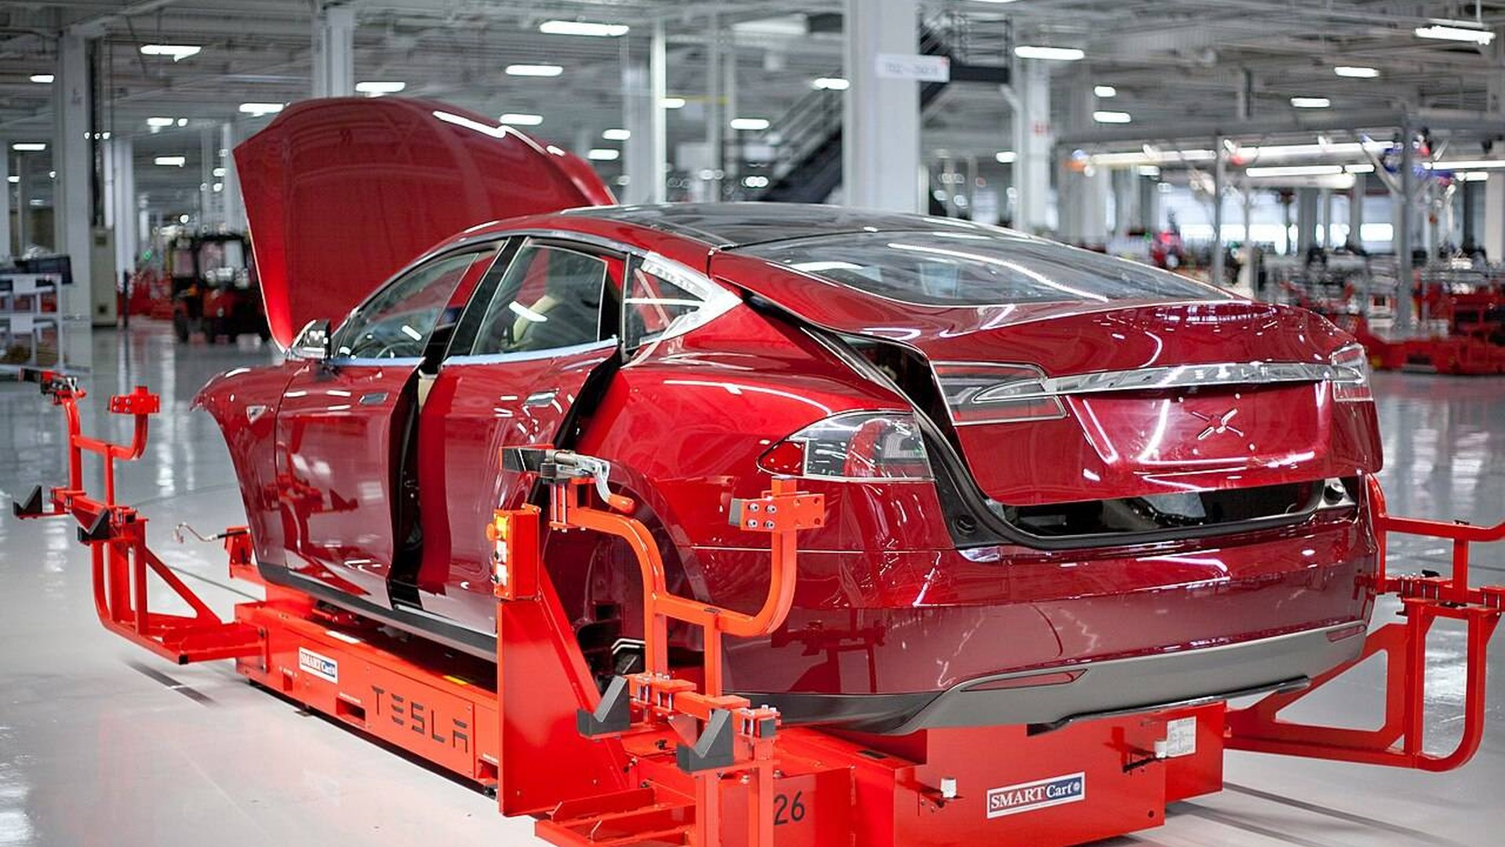
Next
Robotics · next
Optimus v3 — factory hands that earn their keep
Unsupervised FSD — driving without a safety driver
Physical AI workers — labor that scales like software
Steve Jurvetson
muskroadmaps.com · not affiliated
engineering, not politics

Slide 34
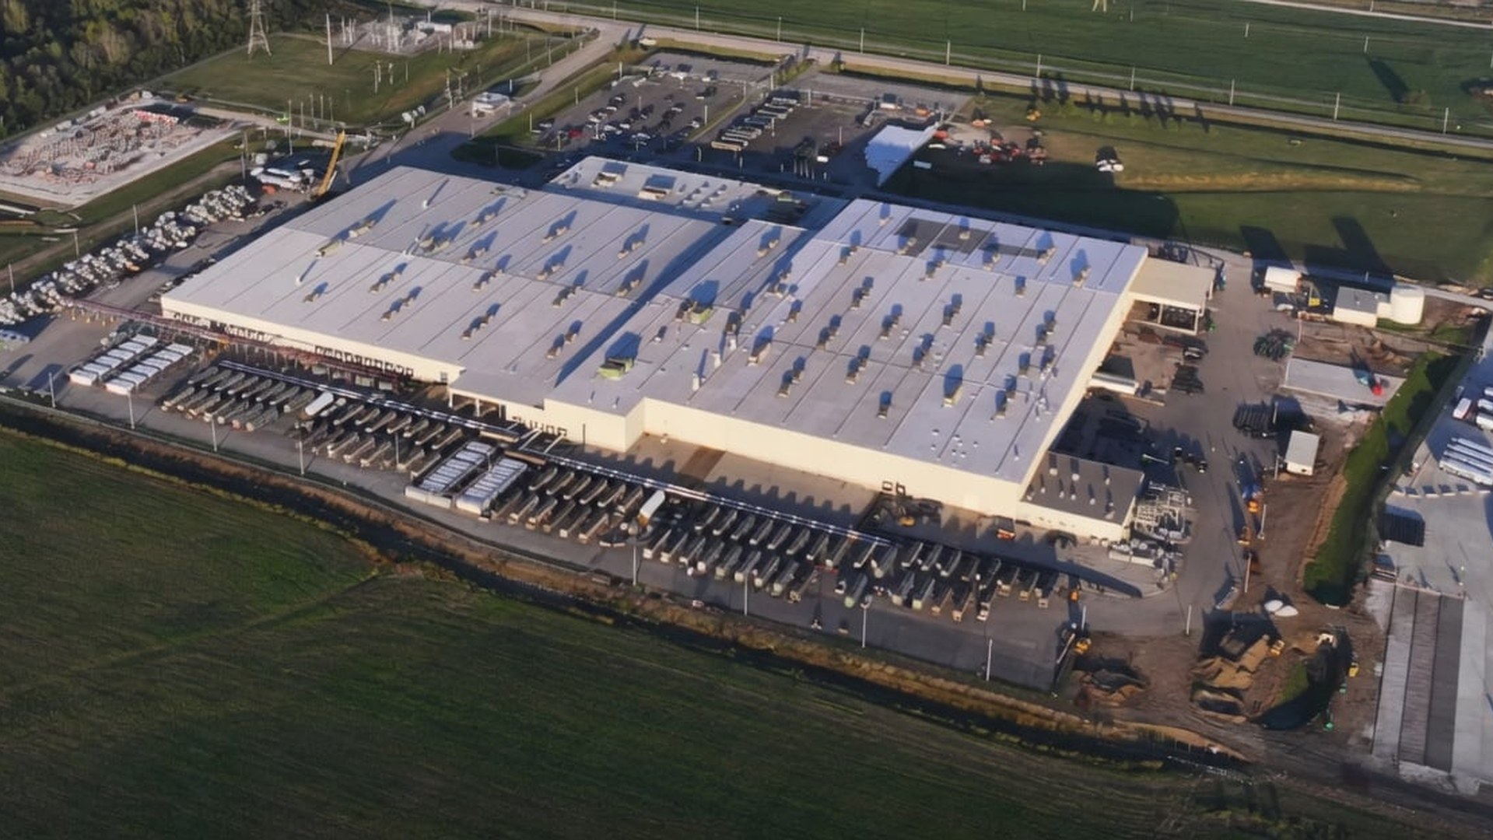
Intelligence & action
Compute
Own the full AI stack — training through inference
xAI
muskroadmaps.com · not affiliated
engineering, not politics

Slide 35
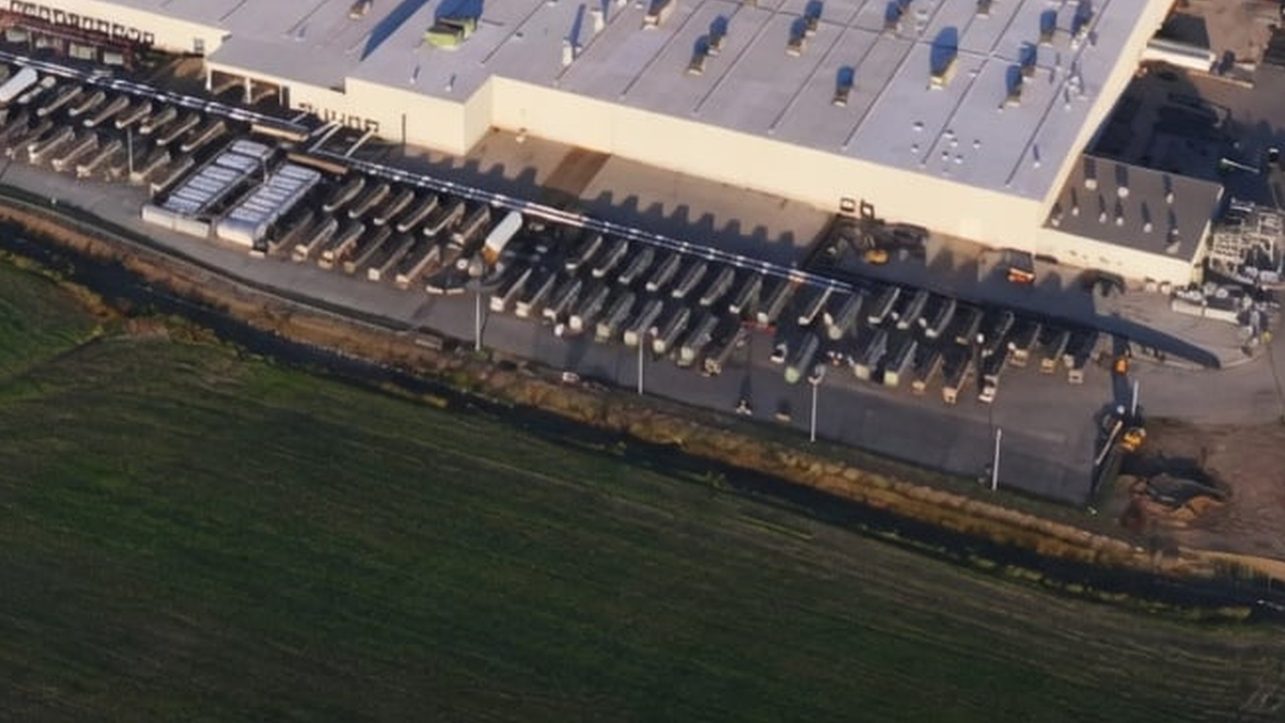
Intelligence & action
Compute · vision
VISION
Own the full AI stack — training through inference. Vertically integrate GPU clusters, proprietary data pipelines, and product inference so model iteration does not depend on third-party cloud or closed datasets.
NOW
Grok live on X; Grokipedia launched Oct 2025.
END
AGI that understands reality — central to the everything-app (X) and autonomous space operations (SpaceX).
xAI
muskroadmaps.com · not affiliated
engineering, not politics

Slide 36
Intelligence & action
Compute · now
START
NOW
2023-07
Grok on X; Colossus campus Memphis.
xAI
WHY IT MATTERS
Own training through inference.
muskroadmaps.com · not affiliated
engineering, not politics

Slide 37
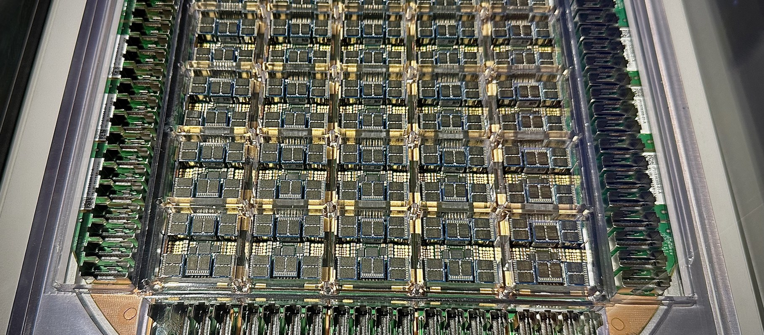
Compute · factories
Compute
Tesla Dojo tile · custom AI silicon
Steve Jurvetson
muskroadmaps.com · not affiliated
engineering, not politics

Slide 38
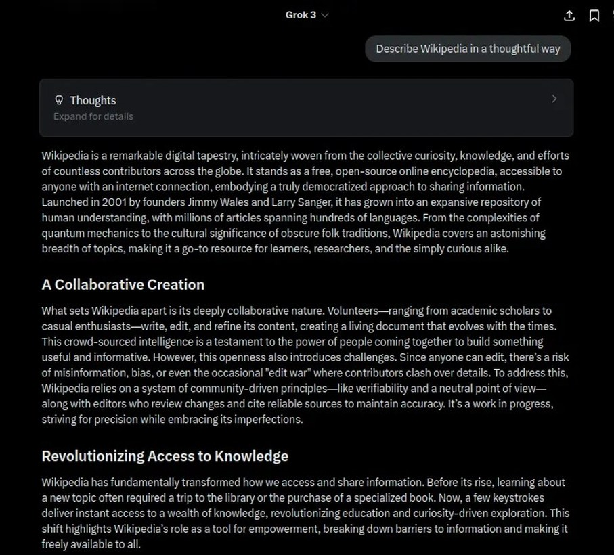
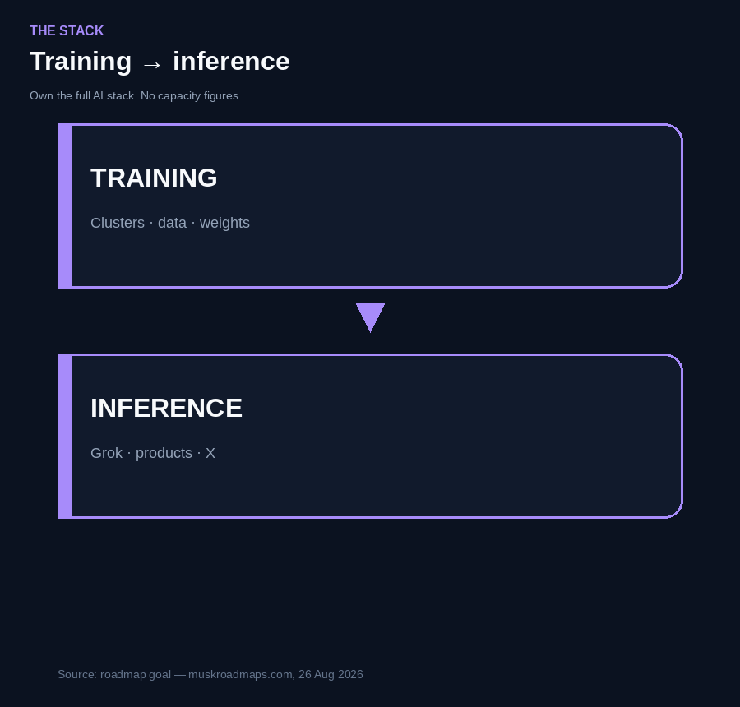
Compute · products
Compute
Grok 3
xAI / VulcanSphere
muskroadmaps.com · not affiliated
engineering, not politics

Slide 39
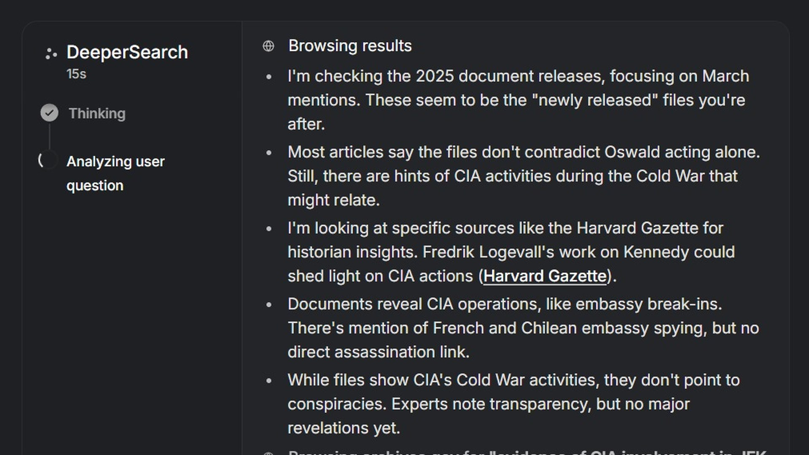
Next
Compute · next
Grokipedia v1.0 — a live encyclopedia Grok can trust
Grok 4.x — see, hear, stay in the conversation
AGI for X and space — one model for the app and the fleet
xAI
muskroadmaps.com · not affiliated
engineering, not politics

Slide 40
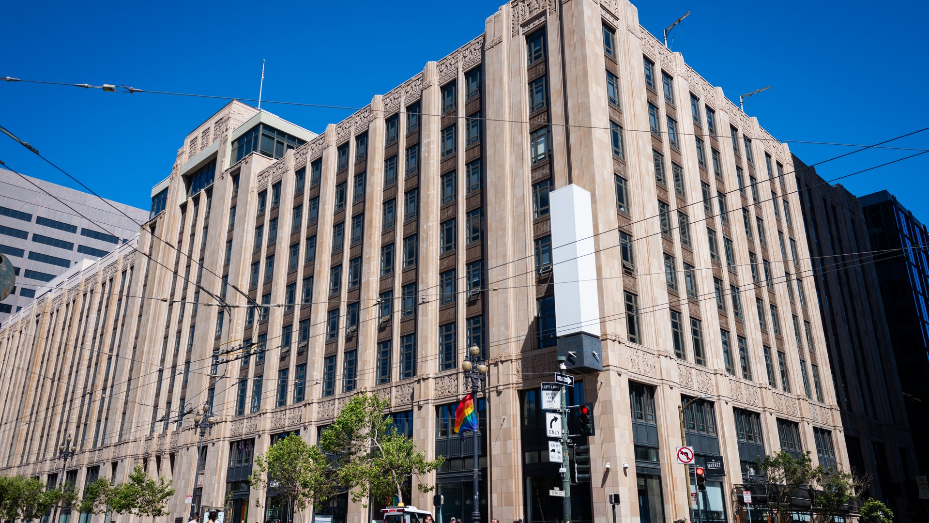
Reach & integration
Platforms
X headquarters · 1355 Market Street, San Francisco
Former Twitter HQ — the public face of the everything-app
9yz
muskroadmaps.com · not affiliated
engineering, not politics

Slide 41
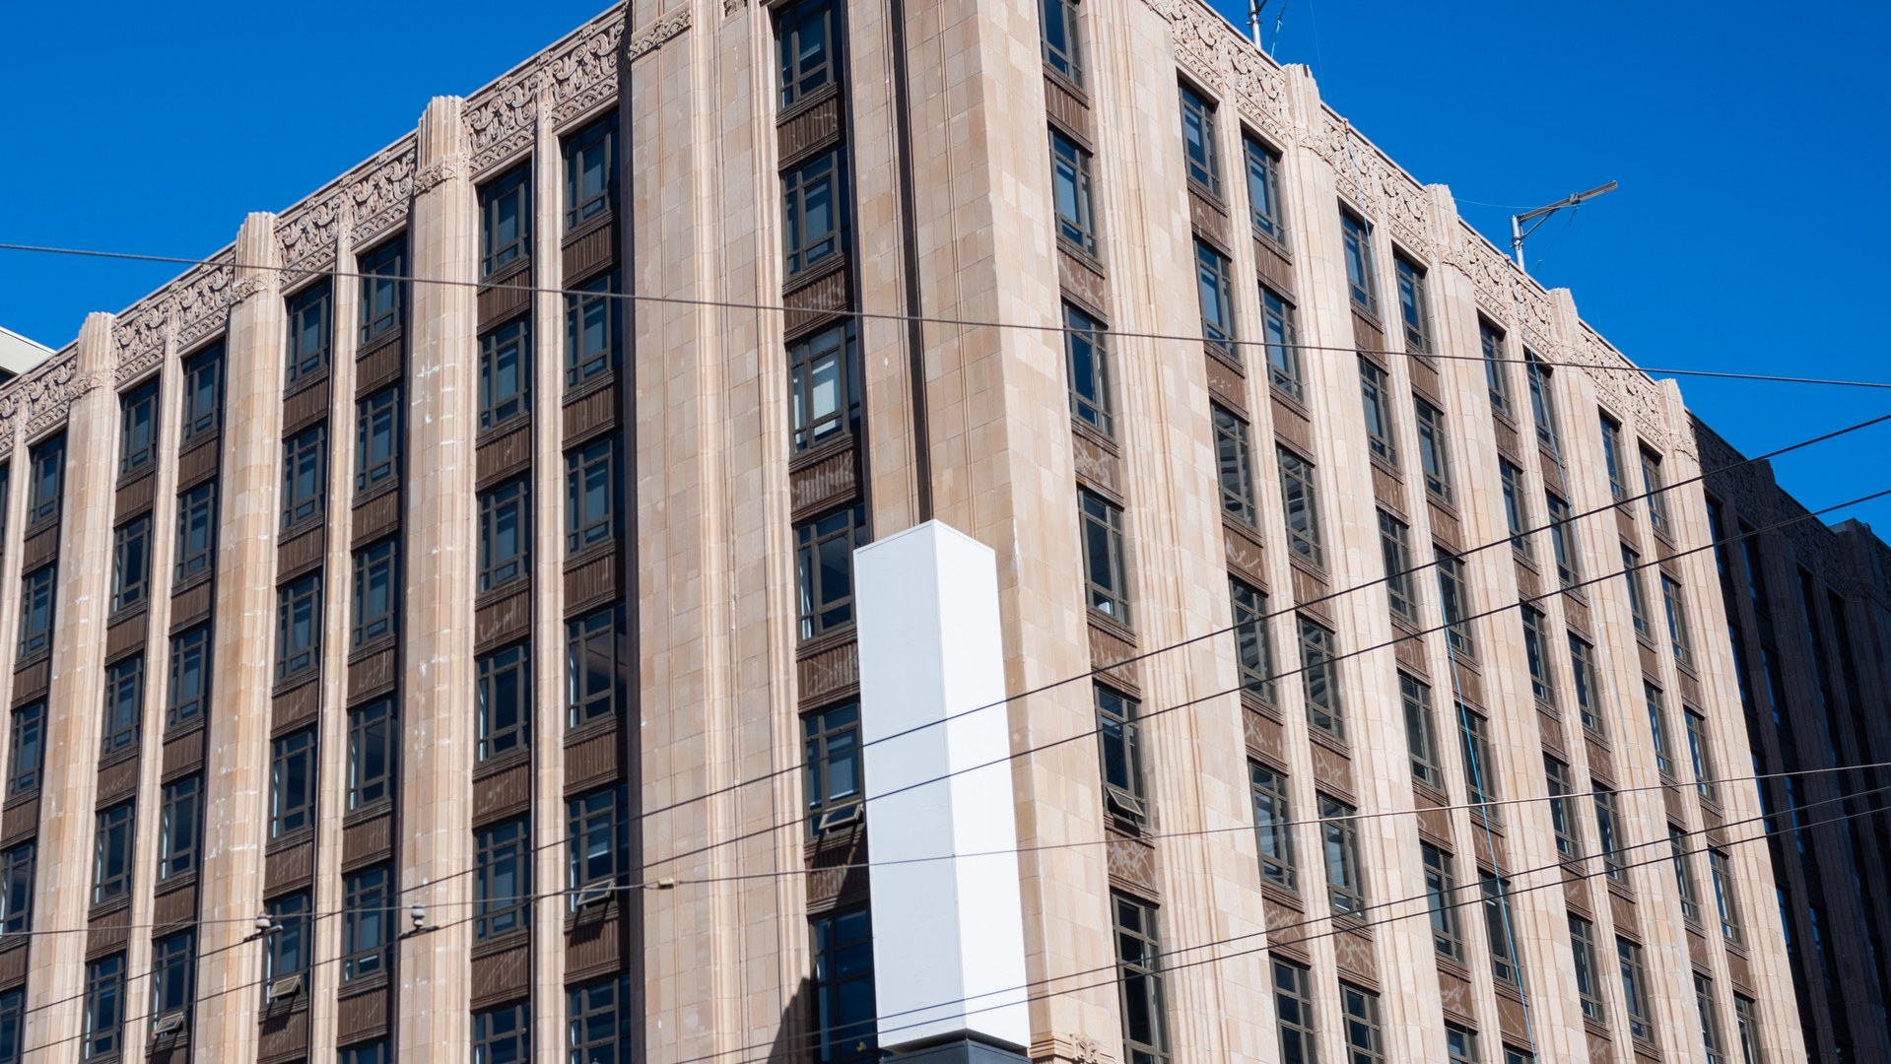
Reach & integration
Platforms · vision
VISION
Unified identity, payments, and AI across endpoints. One platform layer binding social graph, Grok inference, payments (X Money), and device/satellite endpoints — single sign-on and transaction rail for the rest of the stack.
NOW
X rebrand complete; HQ at Bastrop; Grok embedded.
END
The everything app — communication, money, AI, and media in one platform (PayPal vision from 1999, resumed).
9yz
muskroadmaps.com · not affiliated
engineering, not politics

Slide 42
Reach & integration
Platforms · now
START
NOW
1999-03
X rebrand; Grok embedded; take-private 2022.
Zip2
WHY IT MATTERS
Chat, cash, and AI in one login.
muskroadmaps.com · not affiliated
engineering, not politics

Slide 43
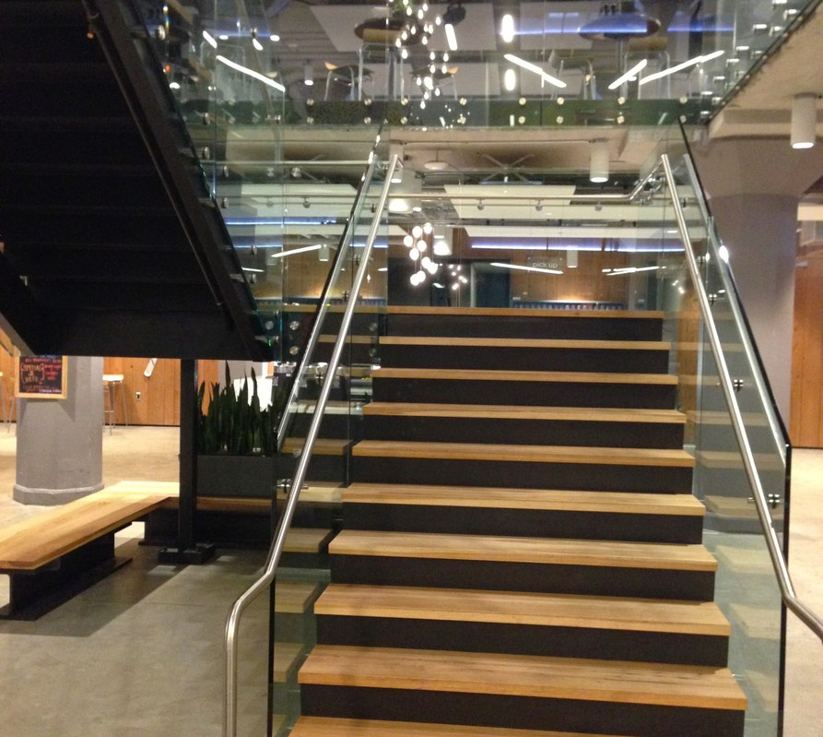
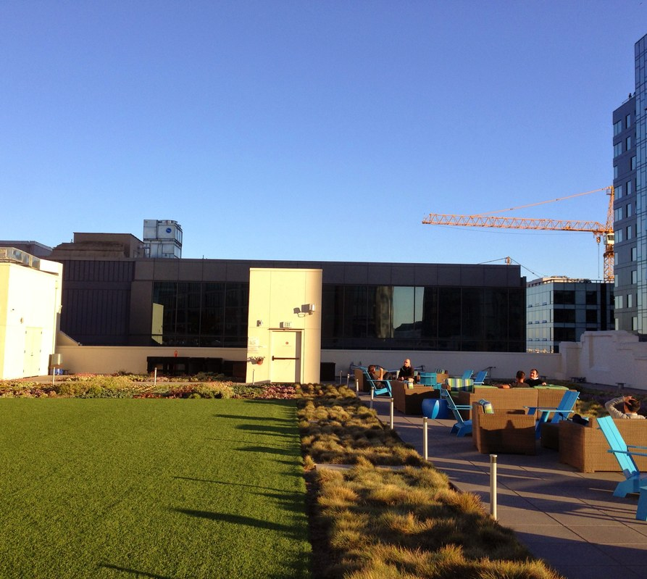
Platforms · factories
Platforms
X HQ · staircase
X HQ · roof terrace
Runner1928
Runner1928
muskroadmaps.com · not affiliated
engineering, not politics

Slide 44
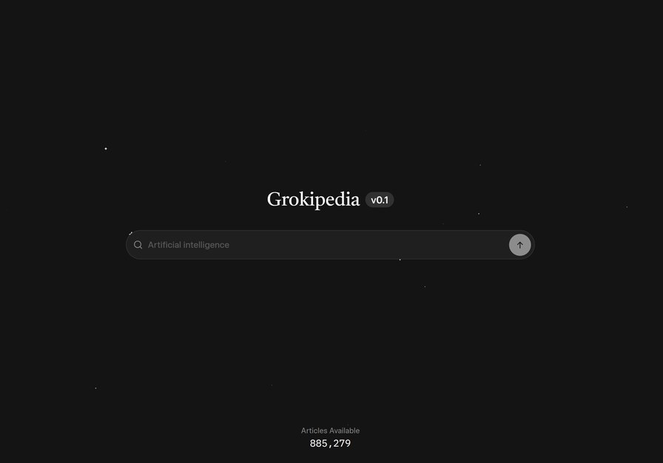


Platforms · products
Platforms
Grokipedia
X · sign-in
xAI / Grokipedia UI
X Corp.
muskroadmaps.com · not affiliated
engineering, not politics

Slide 45

Next
Platforms · next
X Money — send dollars inside the app
Payments and banking — the wallet under the everything-app
The everything app — chat, cash, and AI in one login
Runner1928
muskroadmaps.com · not affiliated
engineering, not politics

Slide 46

Reach & integration
Connect
Vertically integrated LEO broadband stack
Starlink
muskroadmaps.com · not affiliated
engineering, not politics

Slide 47

Reach & integration
Connect · vision
VISION
Vertically integrated LEO broadband stack. Own satellites, launch, user terminals, and ground segment as one network product — bandwidth cost and latency as engineering levers, not leased capacity.
NOW
11,078 working LEO satellites (KeepTrack, 2 Sep 2026); global consumer service.
END
Internet everywhere — funds Mars missions; potential backbone for X after SpaceX / xAI integration.
Starlink
muskroadmaps.com · not affiliated
engineering, not politics

Slide 48

Bars = launched/year (Jonathan's Space Report, 31 Aug 2026). Callout = 11,078 working, KeepTrack 2 Sep 2026. 2026 is YTD.
muskroadmaps.com · not affiliated
engineering, not politics

Slide 49


Connect · factories
Connect
Starlink constellation
SpaceX Hawthorne · Falcon 9
M. Lewinsky
Steve Jurvetson
muskroadmaps.com · not affiliated
engineering, not politics

Slide 50


Connect · products
Connect
Starlink terminal
Starlink mission
Wikideas1
SpaceX
11,078
working satellites
KeepTrack, 2 Sep 2026 · muskroadmaps.com data
muskroadmaps.com · not affiliated
engineering, not politics

Slide 51

Next
Connect · next
Starlink v3 — more bits per satellite, cheaper rural internet
Polar coverage — no dead zones at the map's edge
Internet to Mars — the same network the ships will use
U.S. Space Force
muskroadmaps.com · not affiliated
engineering, not politics

Slide 52

Reach & integration
Launch
Reusable heavy-lift at commodity $/kg
Steve Jurvetson
muskroadmaps.com · not affiliated
engineering, not politics

Slide 53

Reach & integration
Launch · vision
VISION
Reusable heavy-lift at commodity $/kg. Drive $/kg to LEO low enough that launch cadence becomes a scheduling problem, not a budget problem — enabling constellation deploy, refueling, and Mars cargo as downstream.
NOW
Falcon 9/Heavy dominate commercial launch; Starship test program at Starbase.
END
Make life multiplanetary — Mars settlement; Starship as the planet-hopper.
Steve Jurvetson
muskroadmaps.com · not affiliated
engineering, not politics

Slide 54

KeepTrack · GCAT catalog · 2 Sep 2026. 2026 is year-to-date.
muskroadmaps.com · not affiliated
engineering, not politics

Slide 55


Launch · factories
Launch
Starbase · Boca Chica
Starbase launch site · 2026
Lars Plougmann
Wikimedia Commons
muskroadmaps.com · not affiliated
engineering, not politics

Slide 56


Launch · products
Launch
Falcon Heavy · LC-39A
Crew Dragon
NASA
NASA / SpaceX
muskroadmaps.com · not affiliated
engineering, not politics

Slide 57

Next
Launch · next
Orbital refueling — tankers so Starship can leave Earth
Starship HLS Moon — land NASA crew on the surface
Life multiplanetary — a second place humans can live
Steve Jurvetson
muskroadmaps.com · not affiliated
engineering, not politics

Slide 58







It is one system
Cars, robots, energy, launch, and neural lean on each other.
Starbase · Boca Chica
Starbase · Boca Chica
Optimus
SpaceFrom.Space
Mobilus In Mobili
Steve Jurvetson
SpaceX Hawthorne
Dragon · Hawthorne
TBM cutterhead
Steve Jurvetson
Steve Jurvetson
Steve Jurvetson
muskroadmaps.com · not affiliated
engineering, not politics

Slide 59

The factory is the product.
Every Giga is a copyable operating system.
Larry D. Moore
muskroadmaps.com · not affiliated
engineering, not politics

Slide 60

Follow the stack
muskroadmaps.com
Map
Developments
October 2026 journal
sites as one system
what moved
field notes
Harry (The Hague) & Bernard de Groot (Deventer) · TU Delft EEs
muskroadmaps.com · not affiliated
engineering, not politics

Slide 61
Photo credits
Full list: CREDITS.md · Wikimedia, NASA (public domain), official company stills, muskroadmaps.com
Steve Jurvetson — Loop station · Vegas; Prufrock TBM; Boring Company TBM; Giga Nevada · construction; N1 impla
dllu — Cybertruck
Wikimedia Commons — Optimus; Giga Berlin · Grünheide; Giga Nevada · Sparks; Powerwall 3; Starbase launch site
Kevauto — Model Y
The Boring Company — Vegas Convention Loop; Loop tunnel; Tesla in Loop tunnel
xAI / VulcanSphere — Grok 3
Wikideas1 — Megapack; Megapack + solar; Starlink terminal
9yz — X HQ · 1355 Market St
China News Service — Giga Shanghai; Giga Shanghai · night; Giga Shanghai · line
xAI / Grokipedia UI — Grokipedia
Runner1928 — X HQ · staircase; X HQ · roof terrace; X HQ · roof skyline
X Corp. — X · sign-in
Gabeincal — Giga Press · Fremont; Giga Press foundations · Texas
Starlink — Starlink night sky
Larry D. Moore — Giga Texas · 2021; Giga Texas · Austin
M. Lewinsky — Starlink constellation
Neuralink — Neuralink hardware; Telepathy clinical program
U.S. Space Force — Starlink launch · Cape
xAI — Colossus campus · Memphis; Grok DeepSearch
Lars Plougmann — Starbase · Boca Chica
SpaceX — Starlink mission; Starship · Mechazilla catch
NASA — Falcon Heavy · LC-39A
Oak Ridge National Laboratory — Li-ion cells
NASA / SpaceX — Crew Dragon
Michael Wolf — Giga Berlin · Grünheide
SpaceFrom.Space — Starbase · Boca Chica
HaeB — Neuralink · Pioneer Building
Mobilus In Mobili — Starbase · Boca Chica
Leijurv — Neuralink surgical robot
Not affiliated with Elon Musk or his companies. Unknown figures shown as — or ~. Updated from public sources, 26 Aug 2026.
muskroadmaps.com · not affiliated
engineering, not politics

